Slide 1
AmeriCorps Supervisor Training
Updated 10/10/2022
Katie Sylvis

Slide 2
WELCOME TO AMERICORPS!
Habitat for Humanity of Iowa is excited to welcome you to our AmeriCorps Program! Contact us with any questions, concerns, or feedback at:
Katie Sylvis, AmeriCorps Program Director
kzellmer@iowahabitat.org / 515-344-3790
Or Julie Little, Outreach and Training Coordinator
jlittle@iowahabitat.org / 515-266-6886
Notes:
About Habitat Iowa – Advocacy, Training, Resource Development, and Disaster Relief

Slide 3
What is AmeriCorps?
A National Service Program, often referred to as the domestic Peace Corps
Federally funded and locally implemented
Benefits the local communities in which member serve by meeting critical community needs
Video -https://www.youtube.com/watch?v=QgdRkzLKlPM
What do AmeriCorps Members Do?
Service minded individuals who devote a term of service to a cause of their choice.
Getting Things Done
Serve a wide variety of communities
Notes:
AmeriCorps is a network of national service programs that engage more than 75,000 Americans each year in intensive service to meet critical needs in education, public safety, health, and the environment.
While it is federally funded, the program impacts local communities – more than 2,100 nonprofits, public agencies, and faith-based organizations have AmeriCorps members.

Slide 4
Why do members serve?
Members tell us they serve because:
Want to impact their communities
Want experience in the nonprofit world
Want to learn how to be responsible homeowners
What is AmeriCorps to members?
AmeriCorps is an apprenticeship program allowing members to:
LEARN SKILLS
EARN MONEY & SCHOLARSHIPS
SERVE THEIR COMMUNITITES
Notes:
AmeriCorps is a network of national service programs that engage more than 75,000 Americans each year in intensive service to meet critical needs in education, public safety, health, and the environment.
While it is federally funded, the program impacts local communities – more than 2,100 nonprofits, public agencies, and faith-based organizations have AmeriCorps members.

Slide 5
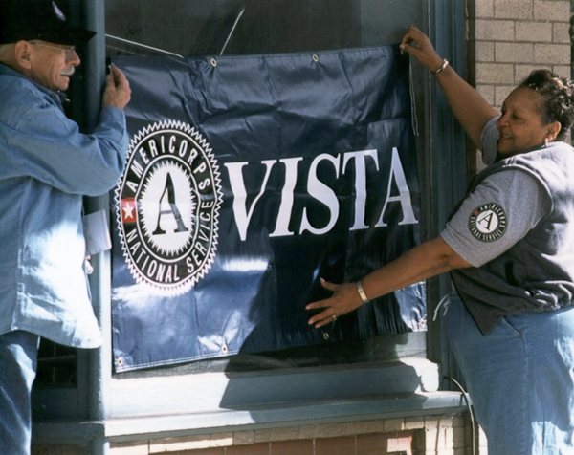
AmeriCorps Branch Examples
AmeriCorps
State/National
AmeriCorps
VISTA
AmeriCorps
NCCC
Notes:
State and National is the largest branch, with about 77,000 members each year. There are both full time and part time opportunities. Habitat for Humanity of Iowa currently has a State AmeriCorps grant.
VISTA – seen as fighting against poverty, VISTA has approximately 7200 members each year. VISTA members focus on capacity building, raising funds, recruiting volunteers, and designing sustainable programs. This is a full time, year long position.
NCCC – this is the smallest AmeriCorps program. The NCCC is a team-based, residential service that focuses on disaster response, environment, housing and youth. Teams travel to projects in neighboring states. Approximately 1100 members serve each year. Members live on 5 different campuses, including in Vinton, IA. This is a full time, 10 month service.

Slide 6
AmeriCorps Terminology
Member, not a volunteer, intern, staff or volunteer.
Members receive a Living Allowance and not a salary or a wage.
Serve/Service should be used rather than work when referring to AmeriCorps time.
Service Site is the location where the member is serving.
Member Service Agreement is the contract the member signs
Position Description outlines the duties and responsibilities of the position.
Nonduplication and Non displacement AmeriCorps members may not duplicate an activity that is already available or displace an employee or position.
Release from service – Fired- Quit
Compelling personal circumstance – fired/quit out of the members control

Slide 7
Recruitment
Recruitment:
Responsibility for recruitment will be shared between Habitat for Humanity of Iowa and the designated host sites. Habitat for Humanity of Iowa program director will provide information and sample recruitment materials to assist in the recruitment process for affiliates. Habitat also has a staff member dedicated to the recruiting through online platforms.
Steps:
Advertise: Habitat Iowa posts positions on online platforms and Affiliates recruit through staff, volunteers, and local school chapters. It is also helpful for affiliates to post on social media, their website and to share the posting with other community organizations.
Apply: Members apply through the Habitat Iowa application portal
Screen: Habitat Iowa staff Screen those candidates and passes candidates to affiliates
Screen/Select: Affiliates interview and select members
Enroll: Habitat Iowa staff enroll those members

Slide 8
Ideal Candidate
Applying for Service, not just a job.
Takes initiative
Willing to learn
Team player
Service Minded
*Any service duty can be learned. Be willing to take a chance on an individual who isn't proficient in construction or communication skills but is full of heart and commitment to the cause.

Slide 9
Where can you look?
Our best candidates come directly from the community and are recruited by word of mouth.
Host sites are encouraged to speak with:
Local volunteers
Staff members
Clients
Local churches
Local school chapters

Slide 10
Applying and Enrolling
Applying:
Member applies at www.iowahabitat.org/apply-americorps
Member has a screening interview with Julie Little (15-25 minutes)
Member is passed onto Habitat staff for formal interviewing
Enrolling Before first day:
Member completes the member information form providing all necessary data to start the enrolling process.
Truescreen – state background check, NSOPW
Field Print – Fingerprinting
My.AmeriCorps account
Electronically fill out employee paperwork
Electronically fill out the contract (member service agreement)
Fill out the i-9 with supervisor (can be after first day)

Slide 11
Developing members
Promotes retention
Improves member effectiveness
Improves organizational quality
Helps members develop skills
Increases member knowledge
Broadens attitudes and perspectives
Augments site and sponsor training
Promotes lifelong engagement
Notes:
There are some bigger picture results when you invest in member development…
•Promote retention—Meeting the individual and professional goals of each member increases member satisfaction and leads to greater member retention.
•Improve member effectiveness—Well-trained members provide high quality, high impact service and increase the value of the AmeriCorps or VISTA program to the organization, site, or sponsor
•Improve organizational quality - Highly competent members significantly improve the quality of services provided by sponsor organizations
•Help members develop skills—Examples include effective communication, conflict resolution, diversity and inclusion, leadership, CPR/first aid, outdoor education, volunteer development, resource mobilization, and partnerships development
•Increase member knowledge—Members learn more about the community they're serving and what national service entails
•Broaden attitudes and perspectives—Training leads to an increased sense of empowerment, civic values, a service ethic, and a broader understanding of how individuals and communities are interconnected
•Augment site and sponsor training—Member development programs can reduce the burden of training for sites and sponsors
•Promote lifelong engagement—Providing members with the skills and confidence necessary for successful service leads to a lifetime commitment to service and civic engagement

Slide 12
Exiting
Most exiting steps can be completed before the official exit date.
Exiting
Exit form on my.americorps.gov
Exit form for Habitat Iowa
Member mid-term and End of Term evaluation
Member homework and quizzes from trainings
Member great story reports
Final Timesheets

Slide 13
AmeriCorps Member Benefits

Slide 14
Member Benefits
Living allowance: The contracted amount of money paid in equal amounts each pay period throughout the term of service. A member may not receive more than the total amount in their Member Service Agreements. ​
Education Award: Each AmeriCorps member is eligible to receive up to two full time education awards in their lifetime. This award is determined by term of service. It can be used towards past federal student loans or towards future education expenses through Title IV schools. The education award is awarded with 60 days of your successful completion of your education term.
Housing Stipend: Available only for members serving as a full time capacity. And then only for a member paying rent or mortgage. Reimbursement of $200 will be provided monthly after receipt of payment is provided.
National Service Forbearance: Members with qualifying federal student loans are able to put those loans into a forbearance , meaning no payments are required during your term of service. Forbearance requests are completed through my.americorps.gov accounts.
Accrued Interest Payments: Members with qualifying federal student loans and have those loans placed in National Service Forbearance, will qualify to have all accrued interested paid off at the end of the year through the National Trust. This is a taxable activity.
Health Insurance: Any member serving in full-time status (40 hours per week) is eligible for the Corps Network health insurance, which is provided through Cigna. 100% of the premiums are paid by Habitat for the members. www.iowahabitat.org/americorps-health-insurance
Childcare assistance: Members serving in a full-time capacity (40 hours per week) may be eligible for childcare assistance. The eligibility is based on the household income and follows the state assistance program. www.americorpschildcare.com
Training and professional development: Habitat for Humanity of Iowa provides training throughout the year. Members will also be provided training opportunities through the Midwest Habitat for Humanity Convention, the Iowa Nonprofit Summit and other conferences. Each member will be trained by their host sites to be successful in their service.

Slide 15
Member Expectations
Member Hours: (www.iowahabitat.org/oncorps)
Term in timesheets 2 times per month (10th and 25th)
Complete minimum number of hours (1700, 1200, 900, 450)
Complete the contract length of time (12, 9, 6, 3 months)
Serve a set schedule (40 or 20 hours per week)
Great Story reporting (www.iowahabitat.org/member-page)
Members must complete a minimum of 2 great stories each year and submit them on OnCorps
Attend Trainings (www.iowahabitat.org/member-training)
Orientation Part 1
Orientation Part 2
4 quarterly in person trainings
Habitat Learns
Optional ADRT
Optional Training: Leadership Certificate, Job Shadowing program, Habitat Iowa Conference, Iowa Nonprofit Summit, Disaster Conference, more
Complete mid and end of term evaluations on the program and supervisors (www.iowahabitat.org/member-page)
Appropriate dress code (always have an AmeriCorps logo on)
Come to service on time.

Slide 16
Dress Code
Members always need to have an AmeriCorps logo on.
This could be a pin, shirt, sticker, name badge.
To help with this Habitat Iowa provides:
1 hoodie (for full time members)
4 shirts (2 for quart time members)
1 long sleeve shirt
1 name badge
Stickers for hard hats
1 pair of sunglasses
1 bag (drawstring)
1 water bottle
Other than that, dress code is up to the sites!

Slide 17
AmeriCorps Training and Professional Development
www.iowahabitat.org/member-training
Training | Date | Homework
Orientation Part 1 | First Day-virtual | Homework and quiz
Orientation Part 2 | About 2 weeks after start- virtual | Homework and quiz
Quarterly Training (4x year) | Every few months- in-person | No
ADRT (optional, but strongly encouraged) | Within 2 months -virtual | Required to attend any disaster deployment
Leadership Certificate | Self paced | Yes
Job Shadowing project | Self paced | Yes
Make-up trainings | Self paced | Homework and quiz

Slide 18
Upcoming Calendar of Events
Supervisor Training:
October 11 and 18 at 3pm – Supervisor Orientation and introduction to upcoming year
Training will be recorded
New supervisors will have a 1:1 orientation with Habitat Staff after September 13th.
Optional Upcoming Trainings:
Sept. 21 - Don Hampton Iowa Disaster Conference -Des Moines All Day
Sept. 22 -AmeriCorps Disaster Response Team Training Virtual or Des Moines - All Day
Oct 21- Volunteer Iowa Swearing in Day Volunteer Iowa Swearing in Day for all Iowa AC members - Virtual - Morning only
Required AmeriCorps trainings:
First Day of Service/ 2nd week of service – Virtual Orientation with Program Staff.
Nov. 1 – QT 1 Habitat Iowa Training All Day
Waterloo |Affordable Housing Crisis / Volunteer Management
Jan. 17 – QT 2 Habitat Iowa Training All Day
Des Moines |Transitional Housing / Conflict Management / MLK Day of Service Group event
May 2 – QT 3 Habitat Iowa Training All Day
Cedar Rapids | Redlining / Diversity / Employability
Jun 20 – QT 4 Habitat Iowa Training All Day
Altoona | Advocacy efforts / Board Practices/ emotional intelligence/ End of Year BBQ
July TBA - Virtual- afternoon
Volunteer Iowa Life After AmeriCorps Training

Slide 19
Leadership Certificate--NEW
Members are eligible to participate in Habitat Iowa Leadership certificate program. This 20-hour program will have members learn and demonstrate leadership skills at their host sites.
Participate in the Job Shadowing project – 4-5 hours
Demonstrate public speaking skills through service (speaking to volunteers, day at the capitol, etc.) 1 hour
Demonstrate leadership in their service site
Complete the following training course 9.5 Hours
More information at www.iowahabitat.org/leadership-certificate

Slide 20
Job Shadowing -NEW
All members are encouraged to participate in a job shadowing program. Members will learn about potential career fields and explore interests for their future. This activity is an allowable AmeriCorps activity and counts towards total training service hours. The job shadowing is not limited to Habitat for Humanity staff
How to Participate in the Job Shadowing project
Read through the How to Have a Successful Job Shadow guide. Consider taking a career aptitude test, if you do not know where to start.
Complete the Job Shadow participation form
The job shadow does not need to be at Habitat specifically. Instead, it should be in field the member wants to work in.
Work with Habitat Iowa staff to find a job shadowing placement
Formally ask and schedule a time to meet with selected contacts
Members can use this prepared email to help with this.
Make sure supervisors approve of this time away from the normal service schedule.
Complete the Job Shadow questionnaire with the selected employees of the interested career field.
Report back to Habitat Staff and their supervisor on their experience through this reflection exercise at the bottom of the Job Shadow Questionnaire.
This activity is counted towards training service hours.
More info at www.iowahabitat.org/job-shadow

Slide 21
Construction Training -NEW
All construction members will be required to have a Construction 101 training with Les Gunderson
Training will take place at Cedar Valley Habitat for Humanity within the first 3 days of service beginning.
Structured training will cover topics such as:
How to prepare for day on a construction site?
What is expected when job shadowing with a supervisor?
Typical day and duties on a construction site
Basic safety on construction site
Basic tools and equipment; What is the trailer and stuff on it?
When you have questions, who do you turn to?

Slide 22
Supervisor Expectations
The ultimate role of the Supervisor is to ensure a successful term of service for your AmeriCorps member. This is an apprenticeship designed for members to learn, earn, and serve their communities.
Most members tell us the reason they sign up is because they want to
Supervisors should assume that they will be supervising a minimum of 5 hours per week.
Orientate members to their position and site
Give mid and end of term evaluations of members
www.iowahabitat.org/supervisor-resource
Complete quarterly performance measure reporting
www.iowahabitat.org/supervisor-resource
Approve Member Timesheets on OnCorps by the 12th and 27th of each month
Www.iowahabitat.org/using-oncorps
Monitor member hours to ensure members are meeting their average weekly hours
Ia.oncorpsreports.com /www.iowahabitat.org/using-oncorps
Monitor Member Activities – Prohibited Unallowed activities
Supervisor timesheets monthly- We use this as in-kind match on the federal grant. -NEW
Encourage professional and personal development of the members

Slide 23
Supervisor Timesheets -NEW
Each host site must provide Supervisor Timesheets 2x per month
We use OnCorps (same timekeeping as members) for submitting timesheets.
Usually supervisors spend about 1-5% of their time with members (meeting 1:1, training, reporting, evaluations)
Click to watch video of how to submit a timesheet:
www.iowahabitat.org/using-oncorps

Slide 24
Supervisor Timesheets -NEW
Go to ia.oncorpsreports.com
Log in> Time Tracking> Supervisor In-Kind Hours
Select Pay Period
Enter information in COLUMN 1 & 3. Nothing else
Column 1 – Hours spent doing grant activities
Column 3 – Brief description of activity (Interviewing candidates, reporting, meeting with member)

Slide 25
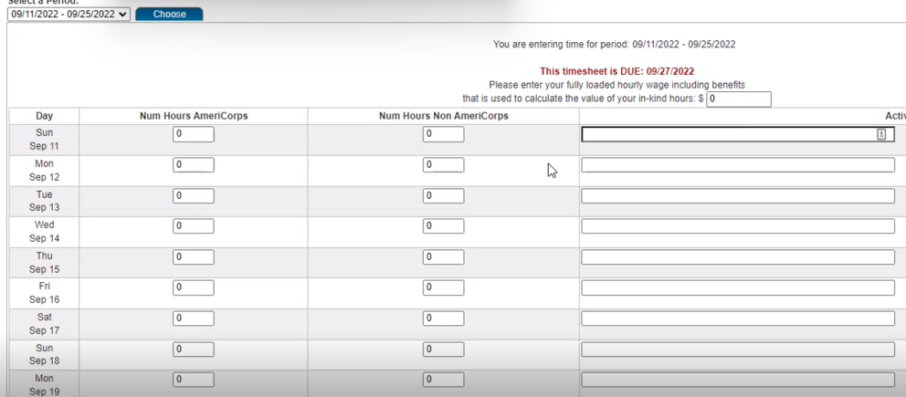

Slide 26
Supervisor Timesheets -NEW
Allowable AmeriCorps Supervisor Activities
Collect data and/or review data on member project/service results
Communicate with member(s) via email/phone
Communicate with sub-site supervisor on member progress/performance
Create/edit position description
Evaluate member(s) on project progress
Meet 1:1 with member(s)
Meet with Habitat Iowa staff about member progress/performance/hours
Meet with other staff about member progress/performance/hours
Plan a training session/event for member(s)
Recruit/interview/onboard new member(s)
Staff meeting (not regularly held but unique for member service)
Timesheet review/approval
Train member(s) on service-relevant topic
Time being trained by Habitat Iowa staff
Time doing activities for Habitat Iowa staff for the grant

Slide 27
Supervisor Timesheets -NEW
Unallowable AmeriCorps Supervisor Activities to count as hours
Work alongside member
Hold regularly scheduled staff meeting where AmeriCorps members attend alongside regular staff
Make fundraising calls
Non-AmeriCorps activities/responsibilities
AmeriCorps prohibited activities such as advocacy and religious instruction

Slide 28
Member Mid and End of Term Evaluations
Site Supervisors play a crucial role in fostering a member’s professional and personal development.
What does the member do well?
What skills are needed to develop further?
What future career/educational paths does the member want to explore?
Evaluations are done with the member. They members have time to comment and offer feedback as well.
Mid-term evaluation (Members serving more than 3 months)
End of term evaluation (All Members, even those that exit early or are fired)
www.iowahabitat.org/supervisor-resource
Member must also fill out an evaluation for supervisors, sites, and program.

Slide 29
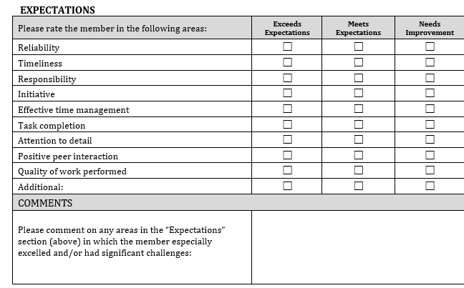
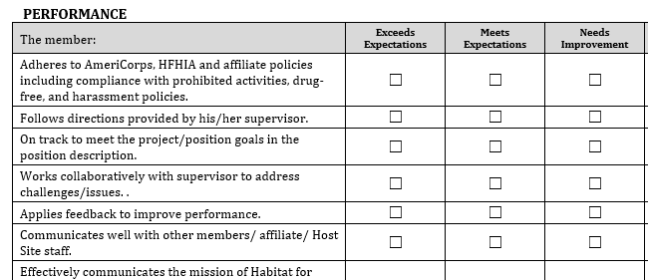
Member Mid and End of Term Evaluations

Slide 30
Supervisor Quarterly Reporting
Site Supervisors play a crucial role in reporting on important data for the AmeriCorps grant. The data is already information that is gathered by Habitats and submitted to HFHI.
Here is are the detailed instructions and example forms.
www.iowahabitat.org/supervisor-resource
Members can help fill it out
# of houses being built, repairs
# of houses complete
# of volunteers/volunteer hours
# of applicants to the AC program

Slide 31
Supervisor Quarterly Reporting

Slide 32
Approving Member Timesheets
Site Supervisors must approve and monitor member hours 2 x per month.
11-25th of the month – due 27th
26-10th of the month – due 12th
Supervisors are checking for accuracy and either approve or reject
After an approved timesheet has been sent to the grant holder, it can’t be unlocked after 90 days. Any mistake after that has be to accepted.
The state monitors how long it takes a supervisor to approve timesheets. If you approve within 20 seconds they send me an email.
Approved timesheets can be corrected by Volunteer Iowa 90 days after the date. Anything after is there permanently.
Time is recorded to the nearest ¼ hour (.25, .5, .75, 0)
Just want the total hours served. Not start and end times
No hours on Holidays, Sundays, or other time the member is unsupervised.
Timesheets are considered federal documents and must be accurate.
Falsified timesheets could be removed requiring us to pay back the grant for false hours paid for.
Here is are the detailed instructions
www.iowahabitat.org/using-oncorps

Slide 33
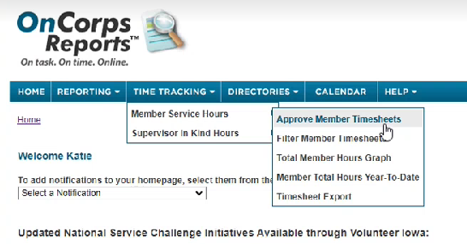
Approving Member Timesheets

Slide 34
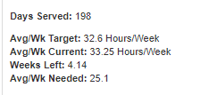
Monitoring Hours on OnCorps
More instructions on how to look at www.iowahabitat.org/using-oncorps
Member must maintain:
Term Length( Start and End Dates)
total number of hours (i.e. 1700 hours, 1200, 900, 450, or 300)
Have a set of regular schedule hours that is either 40 hours or 20 hours
Members have cushion hours built into their schedules each week to help maintain this average.
Members and supervisors can look at average hours served on OnCorps.
Aver/Wk current = What a member is serving on average based on all approved timesheets. (When timesheets are pending or unapproved, this causes the average to be off)
Avg/Wk needed = what OnCorps says the member needs to complete by the exit date
If a member is behind more than 2 hours per week (current Served vs Avg needed), they cannot take vacation time until they are caught back up.
Who can take time off?
Notes:
Figure out issues immediately = avoid missing paychecks

Slide 35
Holidays and Time Off
Members observe the holidays followed by their host site. Typical Holidays for Habitats:
New Years
Good Friday
Memorial Day
Independence Day
Labor Day
Thanksgiving and Friday after
Christmas- 2 days
In addition to the holidays, Members have sick and vacation hours. There is more time off available, but members tend to not serve 40 hours a week and so we must estimate lower to accommodate this.
* This chart assumes that the member will maintain the average hours served EVERY week. If not, the days off will be greatly decreased.
Notes:
Figure out issues immediately = avoid missing paychecks

Slide 36
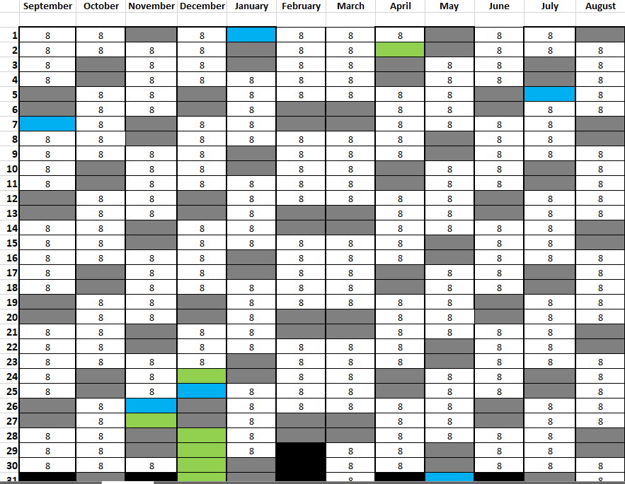
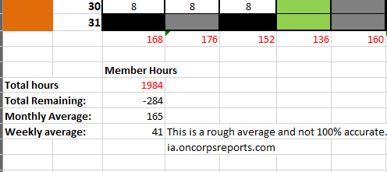
Monitoring Hours on OnCorps- Member Hours Calculator
Notes:
Figure out issues immediately = avoid missing paychecks

Slide 37
Holidays and Time Off- SICK TIME
It is expected that members will from time to time be sick and need to call out of service due to illness or self-care needs. However, members need to help ease the sudden loss of a team member by following these steps:
Contact the supervisor as soon as reasonably possible when the member knows they will be out of service. But no later than 30 minutes before the shift starts. This will allow for supervisors to better plan for the team’s daily activities. The sooner the better when it comes to calling out sick.
Contact the supervisor based on their preference. This could be email, text, or calling.
Notify your supervisor as soon as possible even if it is outside of scheduled service hours.
If a member becomes ill during a normally scheduled service day, contact the supervisor immediately so the supervisor can help with closing the current project the sick member is apart of.
Unscheduled absences will be monitored. An employee will be counseled when the frequency of unscheduled absences adversely affects the operations of the department. Employees who miss more than three (3) consecutive unscheduled days require a doctor’s release to their supervisor permitting a return to service.
Notes:
Figure out issues immediately = avoid missing paychecks

Slide 38
Holidays and Time Off- VACATION
Must follow the host sites policy. If there is no policy follow this below
Some flexibility is built into the calendar to accommodate sick and personal leave. Members are ultimately responsible for ensuring they complete all service hour requirements.
Members should make every effort to maintain a regular service schedule. Personal appointments and time off should be scheduled around set service schedule and holiday breaks as much as possible. Members will be encouraged to stay on track to meet the minimum hours required per the member service agreement.
To Take Time off:
You are required to request TIME OFF at least 7 days in advance of the requested time off (Greater Des Moines requires 14 days), unless it is due to illness or an emergency. You need to contact your supervisor for approval. Approved time off is subject to supervisory approval, department staffing needs and established departmental procedures
Members must also provide the supervisor with a screenshot or print out of the current hour status in OnCorps. Members must show that the average hours served is no more than 2 hours less than average hours needed to successfully complete. This is found in the OnCorps personal account at ia.OncorpsReports.com
Notes:
Figure out issues immediately = avoid missing paychecks

Slide 39
Prohibited Activities
There are many prohibited activities. They are all listed in your member service agreement and here . But they are basically:
NO RELIGIOUS ACTIVITIES
i.e. conducting religious worship, leading prayer,
NO POLITICS (INFLUENCING LEGISLATION)
Voter registrations, calling legislators asking for things, attending protests or boycotts
NO TAKING OVER STAFF POSITIONS
Replacing recently vacant staff position, taking over duties of other staff or volunteers, hiring a member before they finish their term of service.
NO FUNDRAISING
Allowed in very special circumstances
AmeriCorps members are free to and encouraged to participate in these activities on their own time outside of service
Notes:
During your service hours only – what you do on your own time is mostly your own business.
Example: There is a political rally for candidate x at the capitol.
Can you attend?
Yes
What if it is during normal working hours?
As long as you have the time off
Can you attend while wearing AC/HFH gear?
No

Slide 40
Examples of Unallowable Activities
Anything to do with ReStore (considered fundraising)
Taking over staff/volunteer position, even if temporary (considered non-displacement)
Participating in a fundraising event and counting the hours (considered general fundraising)
Example: Being on the planning committee, setting up for the event, working the event.
Researching a candidate or current representative about their stance on housing issues
AmeriCorps members are free to and encouraged to participate in these activities on their own time outside of service
Notes:
During your service hours only – what you do on your own time is mostly your own business.
Example: There is a political rally for candidate x at the capitol.
Can you attend?
Yes
What if it is during normal working hours?
As long as you have the time off
Can you attend while wearing AC/HFH gear?
No

Slide 41
Disciplinary Guidelines
Our goals are to help nurture a member and keep them in the program. However, sometimes members need to be disciplined.
Progression of Discipline (If not threatening to the program or organization)
Informal discussion -- You might not know, but these are the rules here.
Verbal warning -- A warning advising the member they are out of line or insubordinate and the behavior must stop
Written warning -- Create a written document explaining steps for change/improvement with goals as to how this will be met to avoid termination.
Termination of Service aka Firing
Notes:
But please take note of the types of progressive discipline for our program and make sure your direct supervisors are aware of the progression. Most importantly, they should contact the HSM before any of these steps are taken.

Slide 42
Release from Term of Service -Exiting for Cause vs Compelling Personal Circumstance
If a member Exits for Cause (fired/ quit), they will not receive their education award:
Examples:
Being fired
To enroll in school
To obtain employment
Due to dissatisfaction with the program
If a member leaves for compelling personal circumstances, they may be eligible for a prorated amount of the education award.
Examples:
Medical emergency and can’t serve
The primary supporter of the family becomes ill and the member needs to take another job to support the family.
Notes:
You’re making a certain commitment with this agreement – the education award is for completion of that commitment.

