Slide 1
FULL SUPERVISOR TRAINING
For brand new supervisors or those needing refreshers

Slide 2

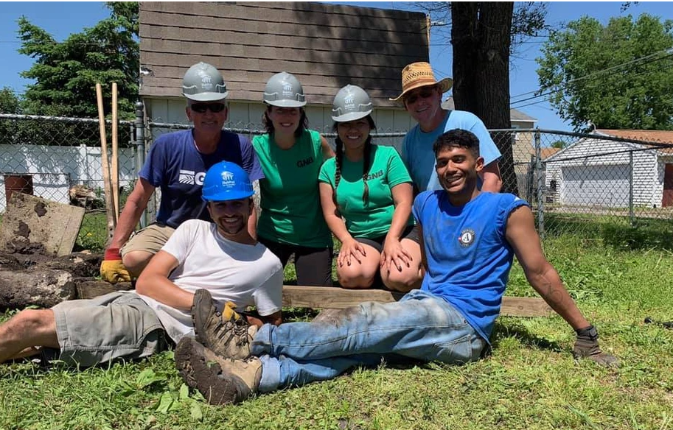

AmeriCorps
Supervisor orientation
Habitat for Humanity of Iowa AmeriCorps Program
Last updated 5/2025- Katie sylvis

Slide 3
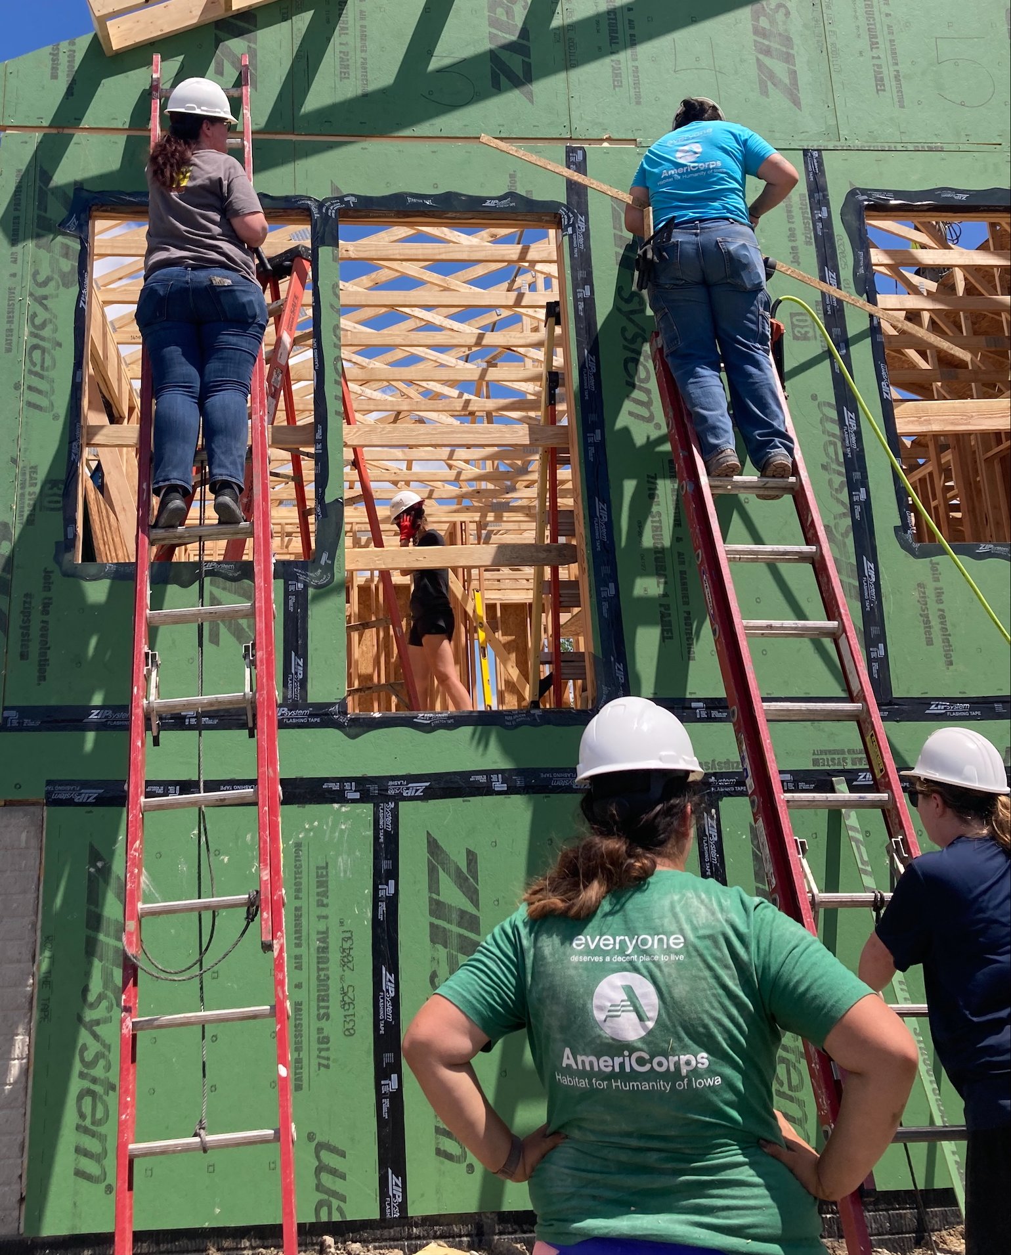
Welcome to AmeriCorps!
Habitat for Humanity of Iowa is excited to welcome you to our AmeriCorps Program! Contact us with any questions, concerns, or feedback at:
Katie Sylvis, Program Director
  kzellmer@iowahabitat.org / 515-344-3790
Main Office -
  info@iowahabitat.org / 515-266-6886

Slide 4
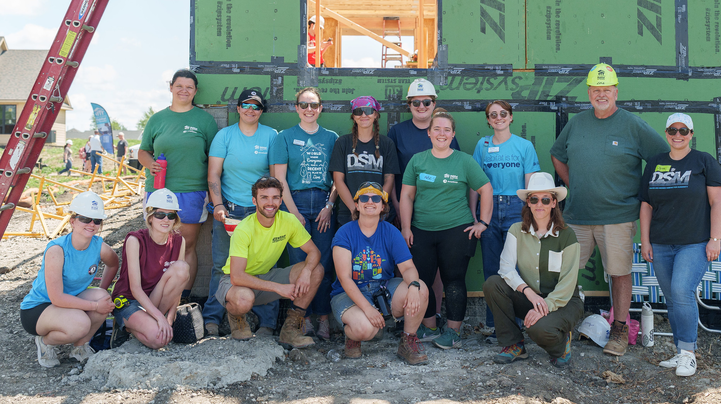
WHERE DO WE SERVE?
Waterloo, Des Moines, Iowa City, Cedar Rapids
Council Bluffs, Pella
Mobile Response Team – Cedar Rapids- Marshalltown
Fairfield; Davenport, Dubuque
Mason City, Newton, Boone

Slide 5
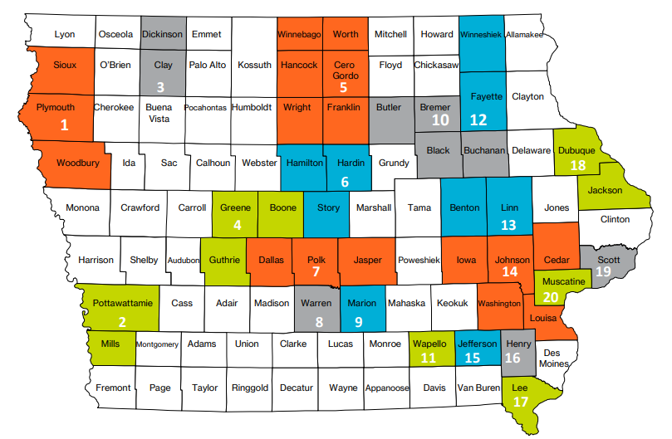

Slide 6


Agenda
What is what? / Who is who?
Supervisor and Member Expectations
Member Benefits
Member Rules and Regulations
Prohibited activities
Online Accounts

Slide 7
What is what?
AmeriCorps
Volunteer Iowa
Habitat Iowa
Habitat International
Habitat Iowa
Local Habitat affiliates
AmeriCorps
Habitat International, Habitat Iowa, Habitat Affiliates
AmeriCorps, Volunteer Iowa

Slide 8
What is AmeriCorps?
AmeriCorps is a network of national service programs, made up of three primary programs that each take a different approach to improving lives and fostering civic engagement.
Many times referred to as the domestic peace corps
Approximately 75,000 Americans across the country participate in AmeriCorps each year. All of them are tackle different community needs in different ways.
Video -https://www.youtube.com/watch?v=QgdRkzLKlPM

Slide 9

What is VOLUNTEER IOWA?
  Volunteer Iowa improve lives, strengthen communities, and foster civic engagement through service, volunteering and mentoring.
  If awarded, AmeriCorps gives grants to Volunteer Iowa (And other State Service Commissions)
  Volunteer Iowa helps Habitat Iowa administer, apply, and spend AmeriCorps funds accurately

Slide 10
AmeriCorps and Habitat
Habitat for Humanity of Iowa administers a federal grant called AmeriCorps.
AmeriCorps gives block grants to Volunteer Iowa (And other State Service Commissions)
Volunteer Iowa helps Habitat Iowa administer, apply, and spend AmeriCorps funds accurately

Slide 11

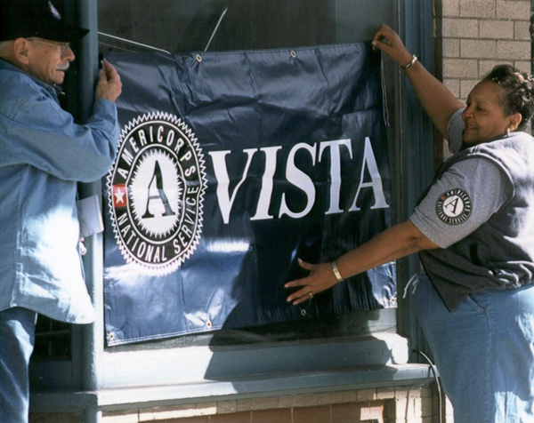

Main branches of AmeriCorps
AmeriCorps Seniors
Foster Grandparents
Volunteer Generation Fund
Climate Corps
FEMA Corps
AmeriCorps
State/National
AmeriCorps
VISTA
AmeriCorps
NCCC
Plus
Others
This is us!

Slide 12
AmeriCorps lingo
AmeriCorps MEMBER – not staff, or volunteer, or intern
SERVICE / SERVING - Not work, working, job
LIVING ALLOWANCE – not salary, hourly pay
Member Service Agreement (MSA)- contract
Position Description outlines the duties and responsibilities of the position.
Nonduplication and Non displacement AmeriCorps members may not duplicate an activity that is already available or displace an employee or position.
Release from service – Fired- Quit
Compelling personal circumstance – fired/quit out of the members control
https://www.youtube.com/watch?v=Oo7_GGNIiT0

Slide 13
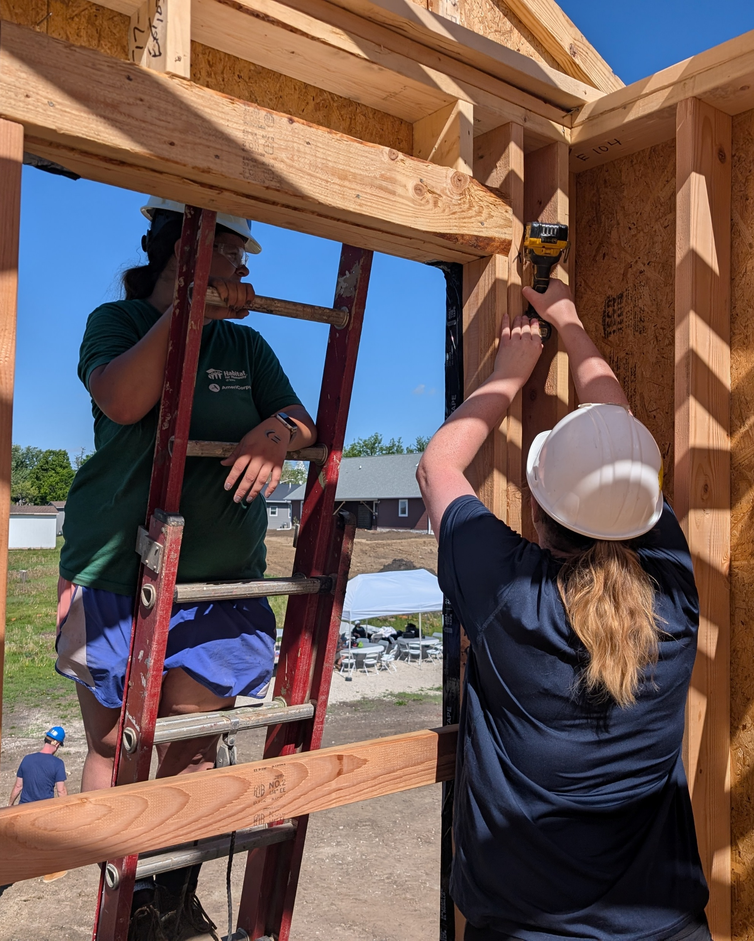
Why do members serve?
Members tell us they serve because:
  Want to impact their communities
  Want experience in the nonprofit world
  Want to learn how to be responsible homeowners
AmeriCorps is an apprenticeship program allowing members to:
  Learn skills
  Earn money & scholarships
  Serve their communities

Slide 14
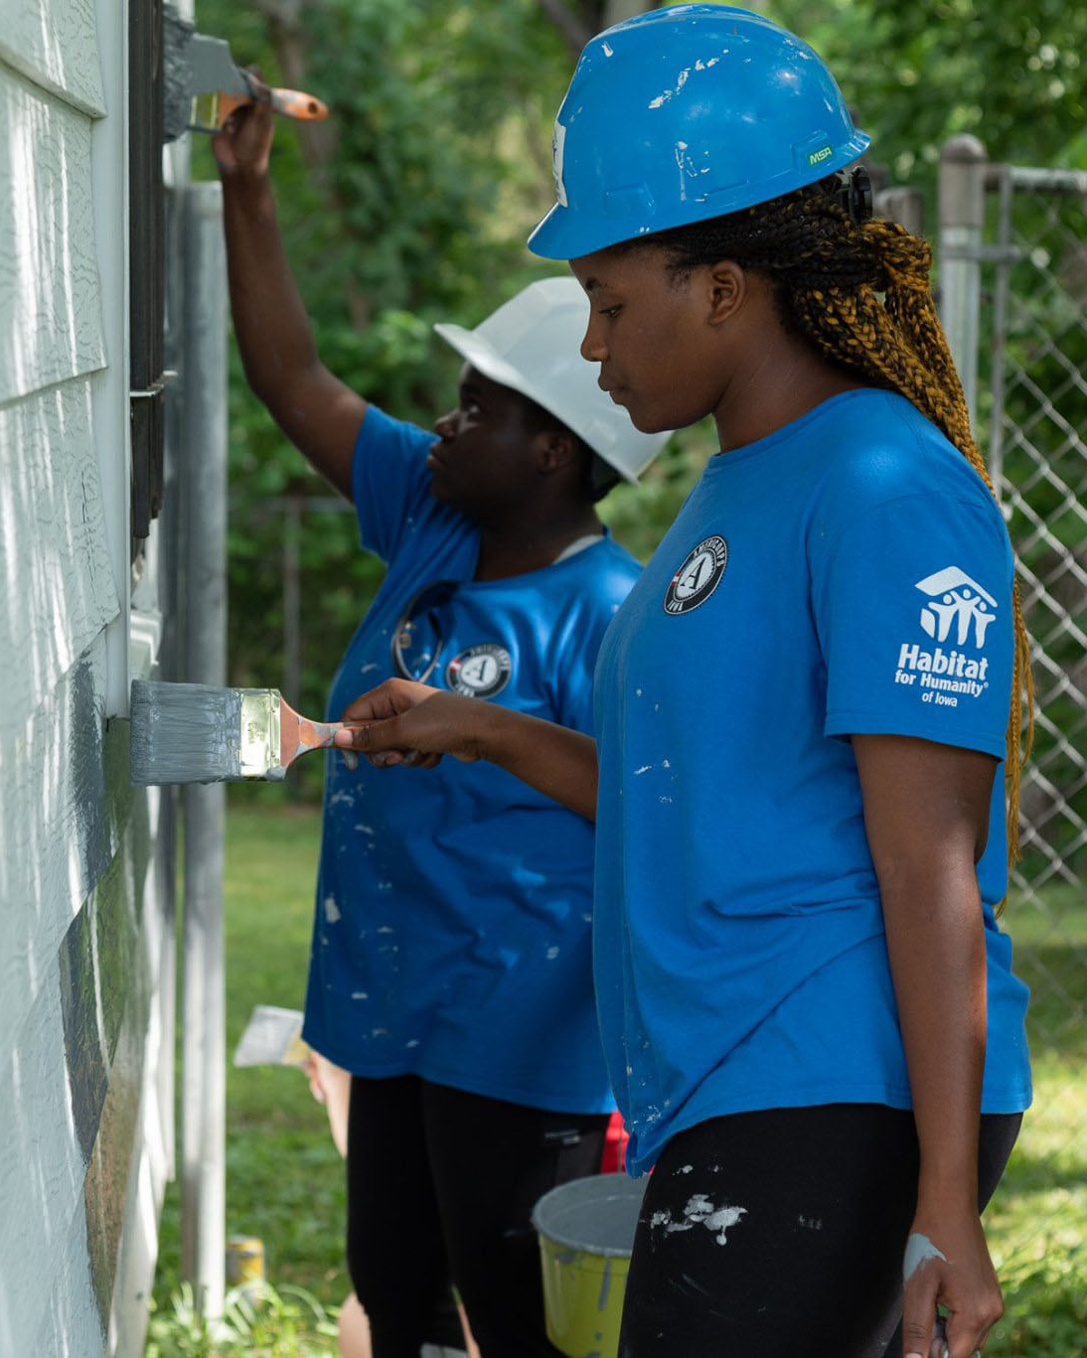
What does a service term look like?
Position Types
  Construction
  Community outreach
  Volunteer Engagement
  Family Services
Service Term Lengths
  12 months – 1700 hours (can be part time)
  9 months – 1200 hours
  6 months – 900 hours (can be part time)
  3 months – 450 hours (can be part time)
  9 weeks – 300 hours (can be part time)

Slide 15

Habitat Iowa Stats
Programming since 2003
Over 600 AmeriCorps members since then
30+ members have become staff
3 types of programs
  AmeriCorps State – Construction
  AmeriCorps State- Disaster
  AmeriCorps VISTA – capacity Building
AC Alum and staff member Lindsay R. created a rap about her service

Slide 16
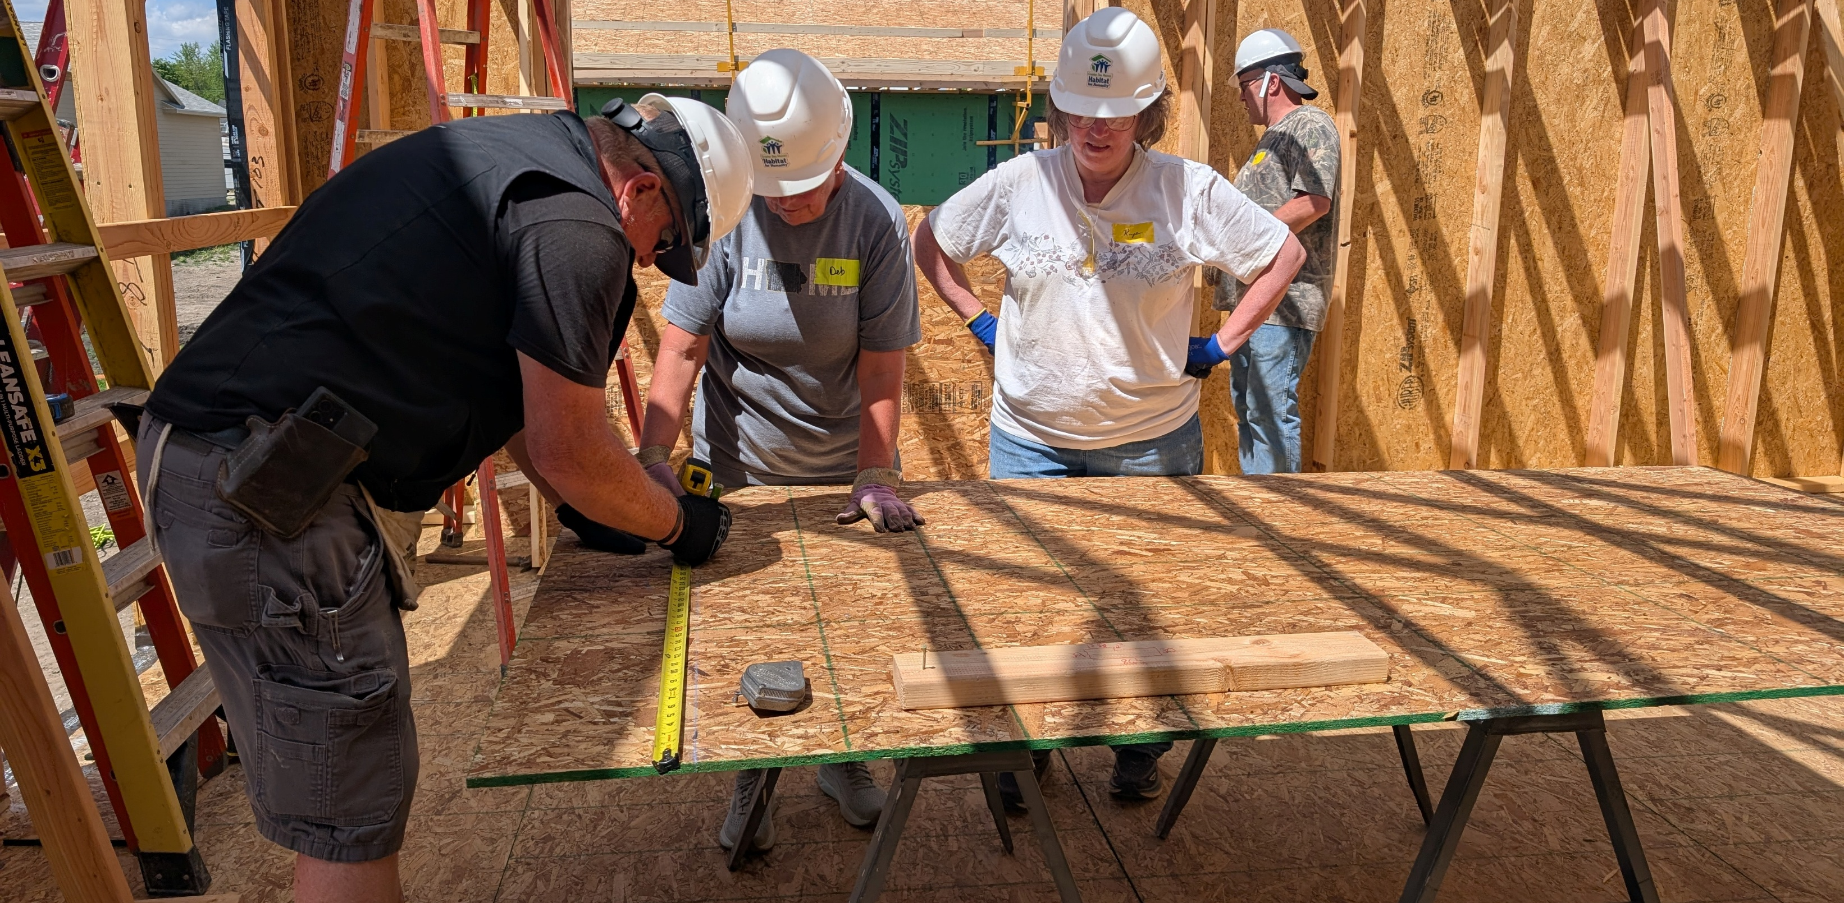
SUPERVISOR EXPECTATIONS
The ultimate role of the Supervisor is to ensure a successful term of service for your AmeriCorps member. This is an apprenticeship designed for members to learn, earn, and serve their communities.

Slide 17
Supervisor Expectations
Supervisors should assume that they will be supervising a minimum of 5 hours per week.
  Recruit and interview Applicants
  Orientate & Exit members to their position and site
  Encourage professional and personal development of the members
  Give mid and end of term evaluations of members ->
    www.iowahabitat.org/supervisor-resource
  Complete quarterly performance measure reporting ->
    www.iowahabitat.org/supervisor-resource
  Approve Member Timesheets on OnCorps by the 12th and 27th of each month ->
    Www.iowahabitat.org/using-oncorps
  Monitor member hours to ensure members are meeting their average weekly hours
    Ia.oncorpsreports.com /www.iowahabitat.org/using-oncorps
  Monitor Member Activities –
    Prohibited Unallowed activities
    Injuries, Behavioral issues
    Member homework assignments
  Supervisor timesheets monthly- We use this as in-kind match on the federal grant. –currently suspended

Slide 18
Recruiting
Recruitment:
Responsibility for recruitment will be shared between Habitat for Humanity of Iowa and the designated host sites. Habitat for Humanity of Iowa program director will provide information and sample recruitment materials to assist in the recruitment process for affiliates. Habitat also has a staff member dedicated to the recruiting through online platforms.
Steps:
Advertise: Habitat Iowa posts positions on online platforms and Affiliates recruit through staff, volunteers, and local school chapters. It is also helpful for affiliates to post on social media, their website and to share the posting with other community organizations.
Apply: Members apply through the Habitat Iowa application portal
Screen: Habitat Iowa staff Screen those candidates and passes candidates to affiliates
Screen/Select: Affiliates interview and select members
Enroll: Habitat Iowa staff enroll those members

Slide 19
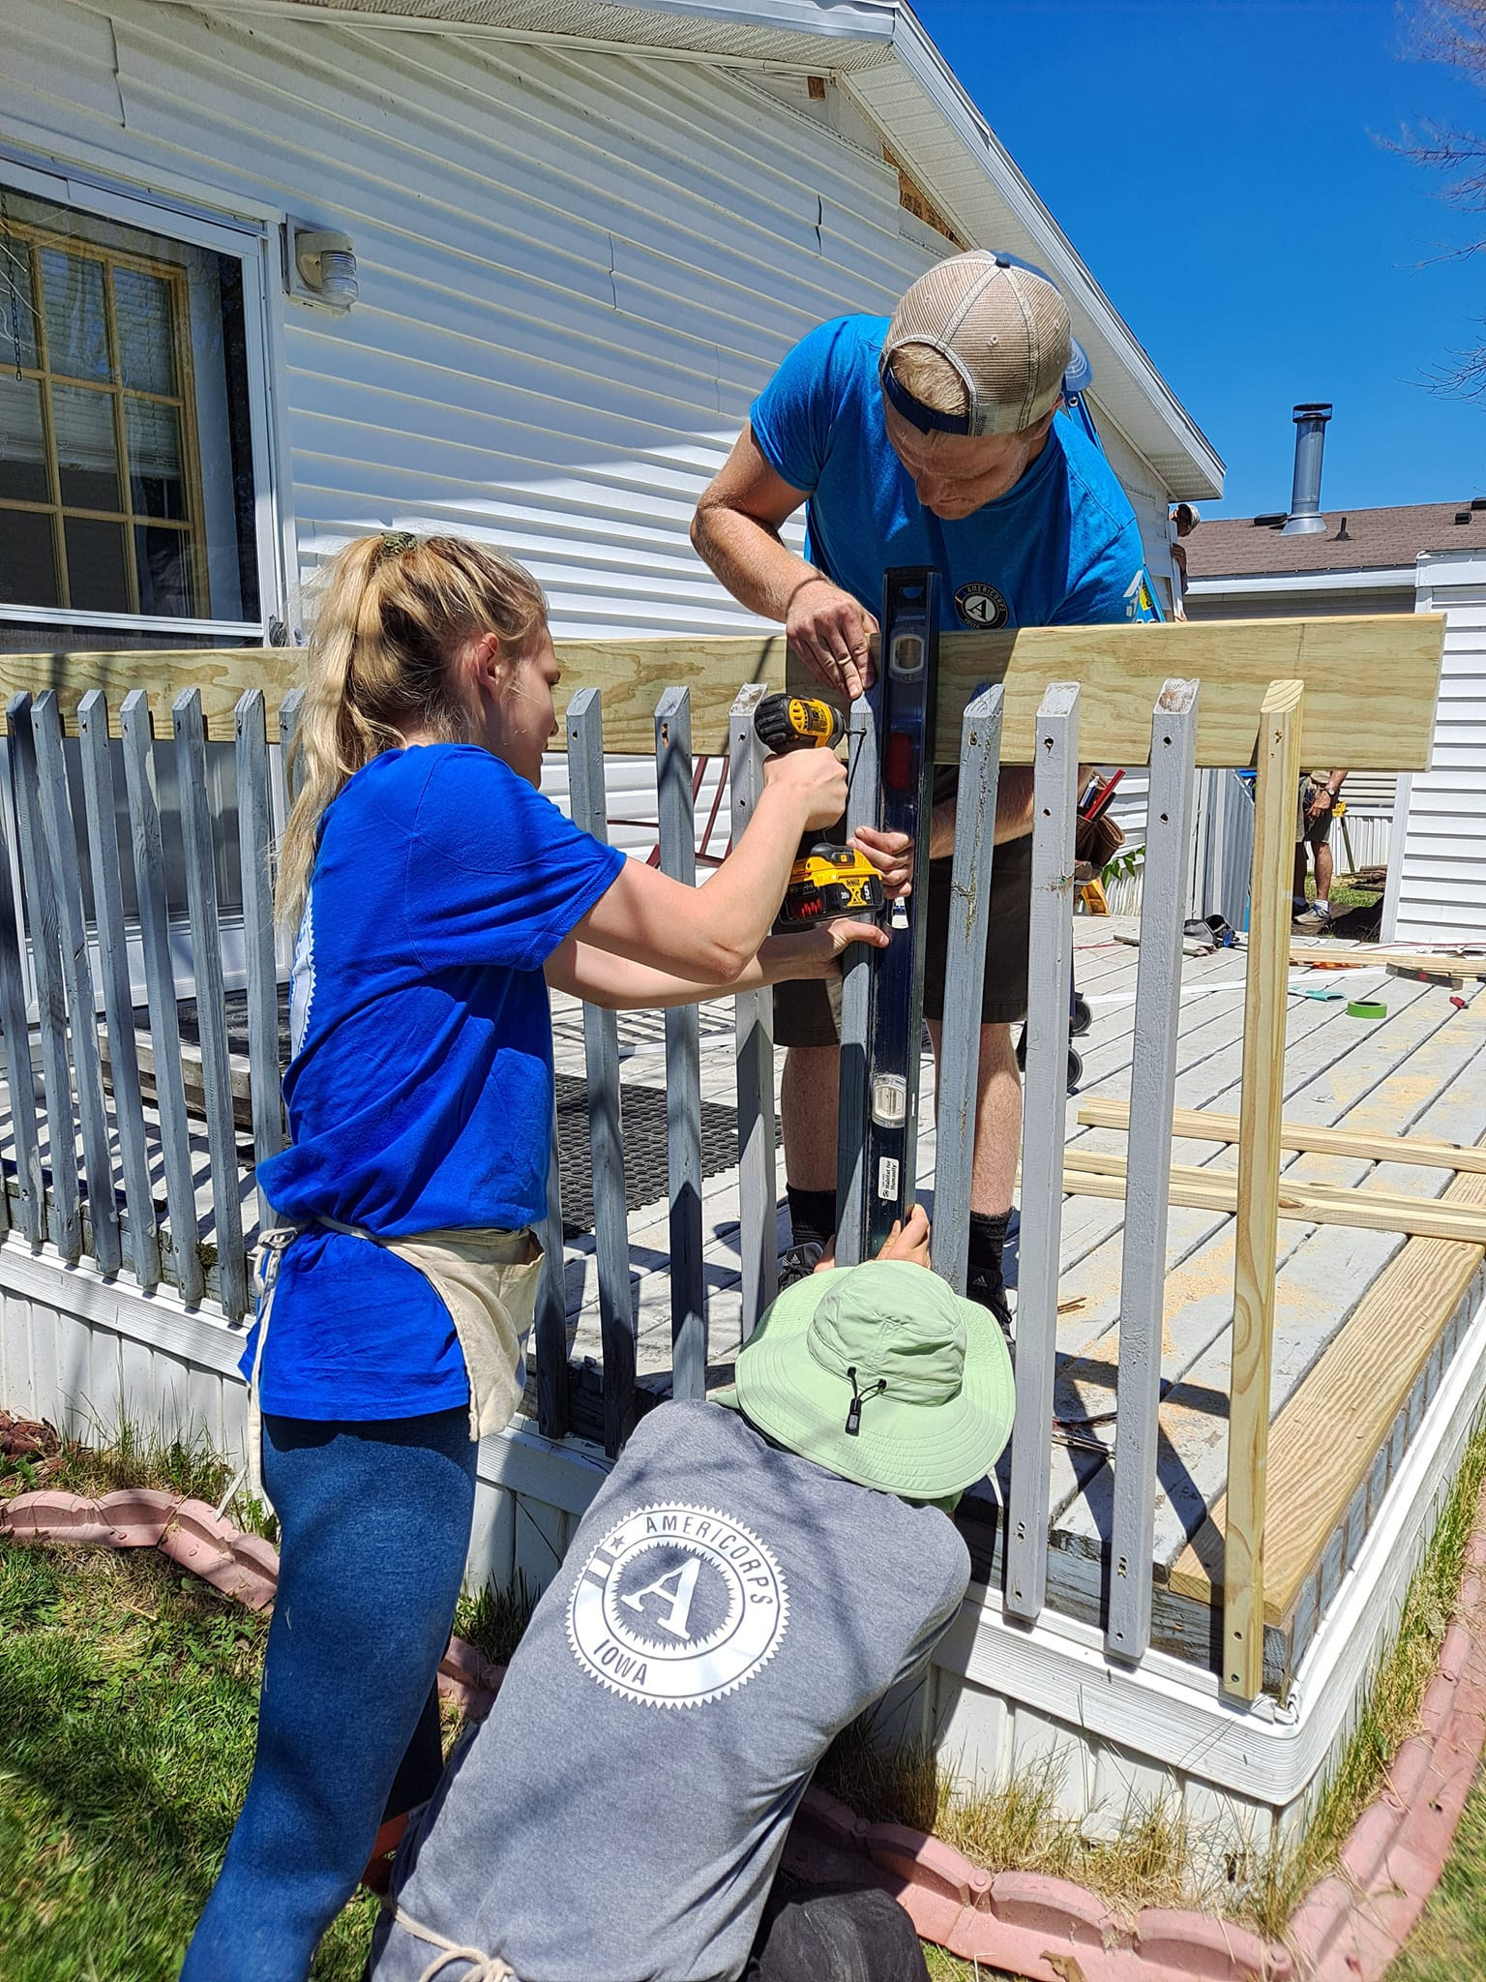
Ideal Candidate
Applying for Service, not just a job.
Takes initiative
Willing to learn
Team player
Service Minded
*Any service duty can be learned. Be willing to take a chance on an individual who isn't proficient in construction or communication skills but is full of heart and commitment to the cause.

Slide 20
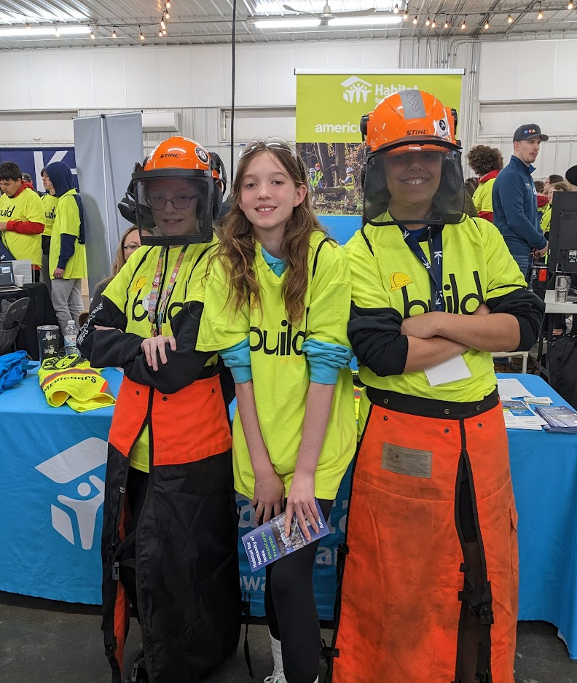
WHERE TO LOOK
Our best candidates come directly from the community and are recruited by word of mouth.
Host sites are encouraged to speak with:
Local volunteers
Staff members
Clients
Local churches
Local school chapters

Slide 21
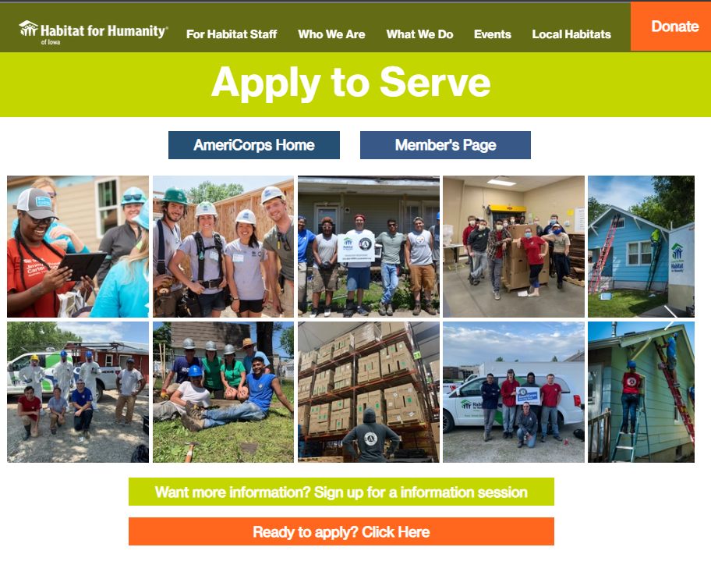
Applying & Enrolling
Applying:
Member applies at www.iowahabitat.org/apply-americorps
Member has a screening interview with Habitat Iowa Staff Member is passed onto Habitat staff for formal interviewing
Enrolling Before first day:
Member completes the member information form providing all necessary data to start the enrolling process.
Truescreen – state background check, NSOPW
Field Print – Fingerprinting
My.AmeriCorps account
Electronically fill out employee paperwork
Electronically fill out the contract (member service agreement)
Fill out the i-9 with supervisor (can be after first day)

Slide 22

Exiting steps
Most exiting steps can be completed before the official exit date.
Exiting
  Exit form on my.americorps.gov
  Exit form for Habitat Iowa
  Member mid-term and End of Term evaluation
  Member homework and quizzes from trainings
  Member great story reports
  Final Timesheets
www.iowahabitat.org/exiting-americorps

Slide 23
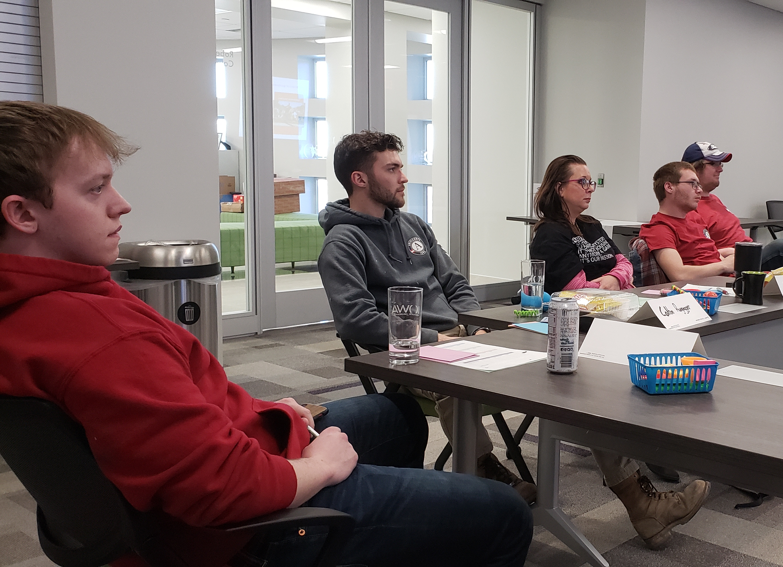
Orientation & Training
Orientation to the site
Orientation to the position and required skills
Encourage professional development opportunities
Allow time for mandatory trainings
Allow hours for self-paced trainings
Allow members to attend Midwest Habitat Conference when grant is paying.
www.iowahabitat.org/member-training

Slide 24
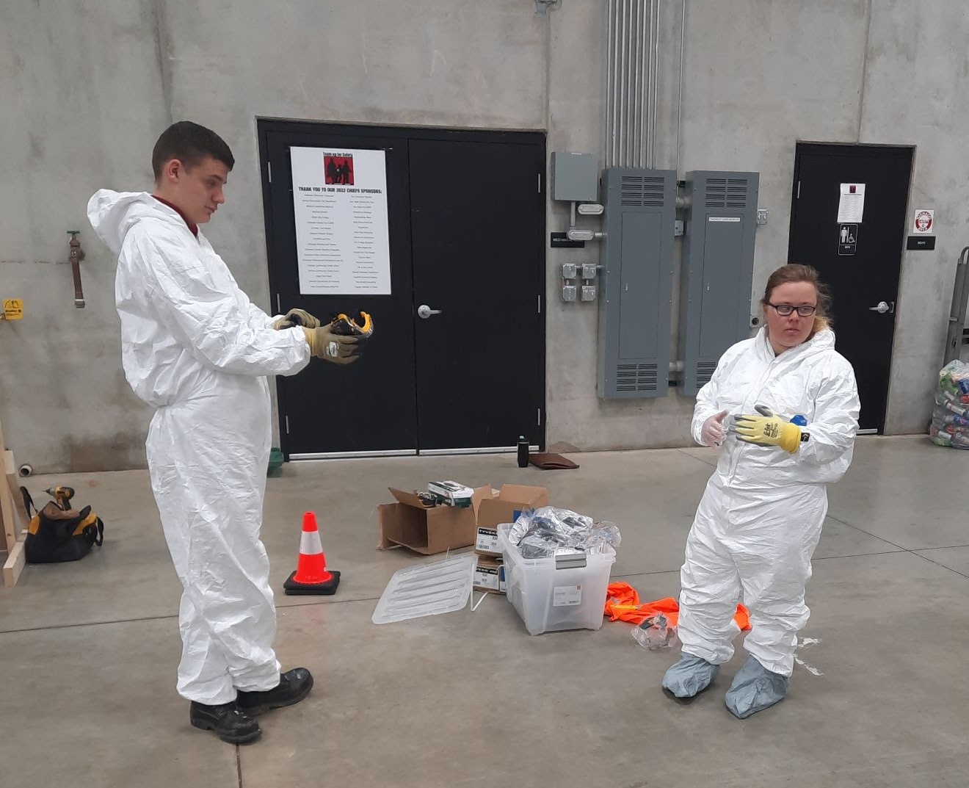
Who covers the cost?
If the training is mandatory or invited by for Habitat Iowa, we’ll cover
  Registration
  Mileage
  If traveling – food, hotel, etc.
Other trainings may also be covered but must be approved beforehand.
www.iowahabitat.org/exiting-americorps

Slide 25
Member Training
Training | Date | Homework
Virtual AmeriCorps Orientation Part 1 (Homework and Quiz) | First Day | Homework and quiz
Virtual AmeriCorps Orientation Part 2 (Homework and Quiz) | First Month | Homework and quiz
QT 1 Training In-person all day | TBA
QT 2 Training In-person all day | TBA
QT 3 Training In-person all day | TBA
QT 4 Training In-person all day | June 25th, 2025
A-DRT Training – MRT mandatory / Optional for others | November and April each year
Competent Persons Training - optional | Online as needed
Current dates listed here: www.iowahabitat.org/member-training

Slide 26
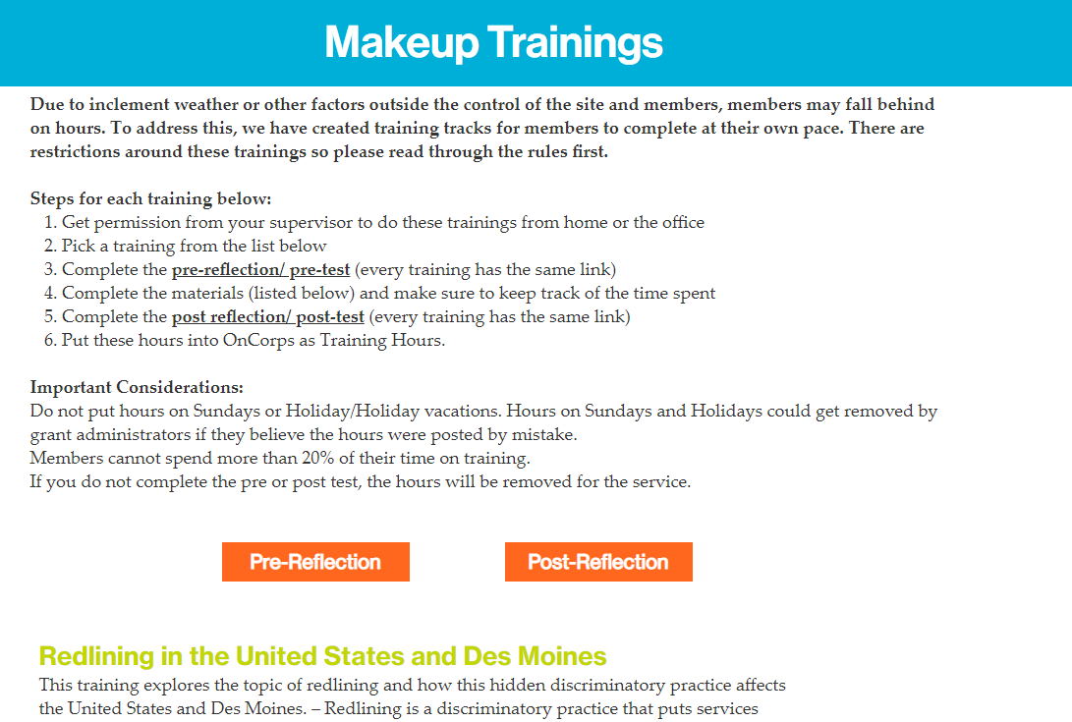
Member Training
www.iowahabitat.org/member-training

Slide 27
Job Shadowing
All members are encouraged to participate in a job shadowing project. We hope this will help members learn about potential career fields. This activity counts towards your total service hours.
What is job shadowing? - Job shadowing is a type of on-the-job training that allows an interested person to follow and closely observe another employee performing specific role. This usually lasts for a few hours and gives time for the member to learn about the roles. This involves asking about the field of work, typical work environments and more. It does not need to be a situation where a member just sits by a staff person if that does not make sense for the role. Instead, members could go to lunch or join them in meeting to really ask questions about the roles.
Where can you job shadow? – members are not limited in where they can job shadow
How do you count hours? – In order for hours to count members must:
Have it approved by supervisor
Complete the questionnaire/reflection
Count hours traveling to and from the meeting and the meeting
How do you start?
Think of a career field/position you want to learn more about
Find someone in a career field that interests you
Get approval from supervisor
Schedule a time to meet with this new person
Fill out this questionnaire with the person you are job shadowing
Members can ask for help from supervisors or Habitat Iowa staff to find potential matches.

Slide 28
Leadership Certificate- CURRENTLY SUSPENDED
If a member completes all components of the leadership academy, they will receive a certification in leadership. This is not required.
Participate in the Job Shadowing project (Location does not need to be Habitat)
Demonstrate public speaking skills through service (speaking to volunteers, Day at the Capitol, etc.)
Demonstrate leadership in their service site signed off by supervisor
Complete Training in the following topics:
  Advocacy
  Conflict Resolution
  Emotional Intelligence
  Diversity and Inclusion
  Employability Skills
  Volunteer Engagement
  Board Skills
More information on completing this project can be found at www.iowahabitat.org/leadership-certificate

Slide 29
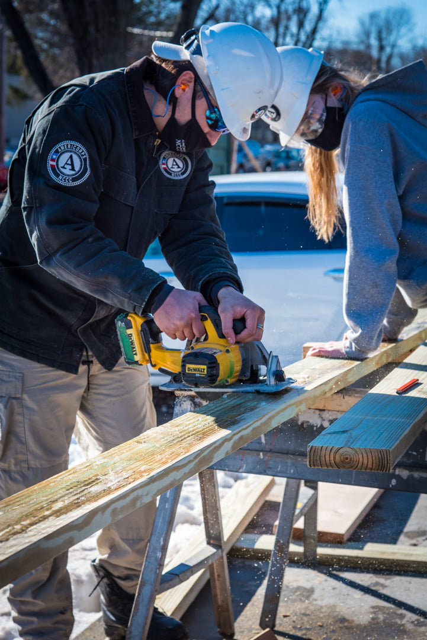
Developing Members
Promotes retention
Improves member effectiveness
Improves organizational quality
Helps members develop skills
Increases member knowledge
Broadens attitudes and perspectives
Augments site and sponsor training
Promotes lifelong engagement

Slide 30

CREATING A WELCOMING ENVIRONMENT
Unhappiness breeds unhappiness
Most pitfalls can easily be avoided by communicating expectations early and often.
Members are brand new to the workforce and don’t know what you want from them.
Think back to your first job and the first day. What would you want to be confident in your new role?
Example: Does starting at 7:30 mean arriving at 7:30 or does it mean ready to go in the Habitat Truck at 7:30?
Is coffee and snacks shared or brought individuals?

Slide 31
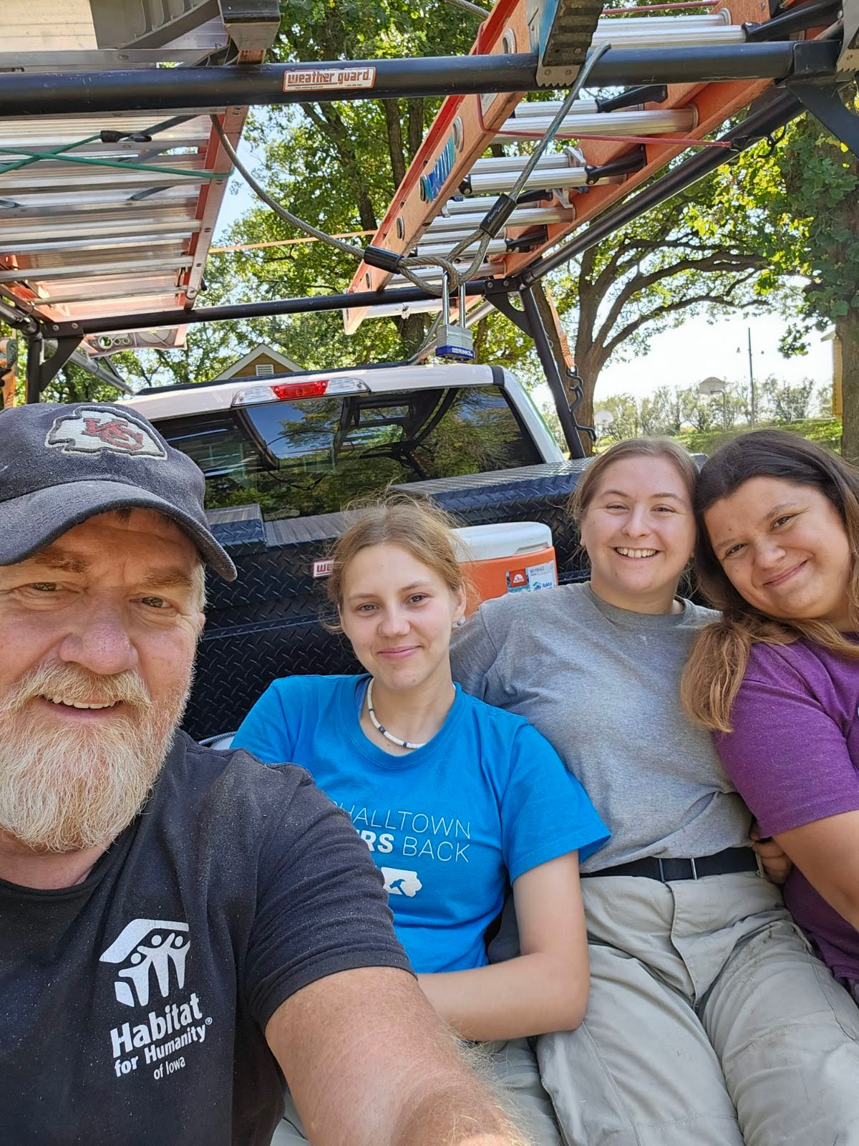
CREATING A WELCOMING ENVIRONMENT
Happiness is contagious
Outside of normal orientation,
Introduce members to the whole team, explore new departments
Invite them to staff meetings
Tell them where to get their questions answered
Set up a regular lunch or event for the members to meet teammates outside of a work setting
  Example: Friday afternoon ice cream trip; Monthly Lunch outing; End of year bowling trip
Take the time to teach the member the cultural of the team so they feel included and confident

Slide 32
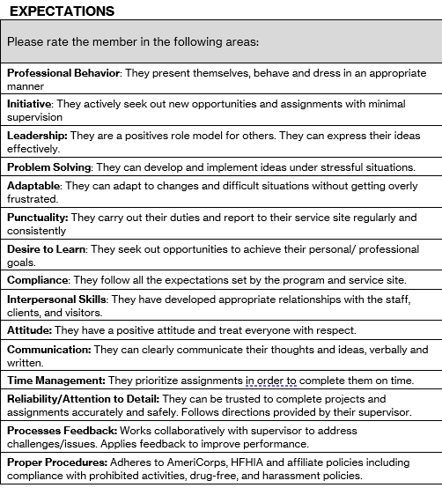
Member and Program Evaluations
2 x per year for anyone over 6-month contracts
Midterm and End of term reviews
Located at www.iowahabitat.org/supervisor-resource
Members also do a review of the program and supervisor

Slide 33
Quarterly Reports
Site Supervisors play a crucial role in reporting on important data for the AmeriCorps grant. The data is already information that is gathered by Habitats and submitted to HFHI.
Here is are the detailed instructions and example forms.
  www.iowahabitat.org/supervisor-resource
Members can help fill it out
# of houses in progress
# of houses complete (new construction/repairs)
# of volunteers/volunteer hours
# of applicants to the AC program

Slide 34
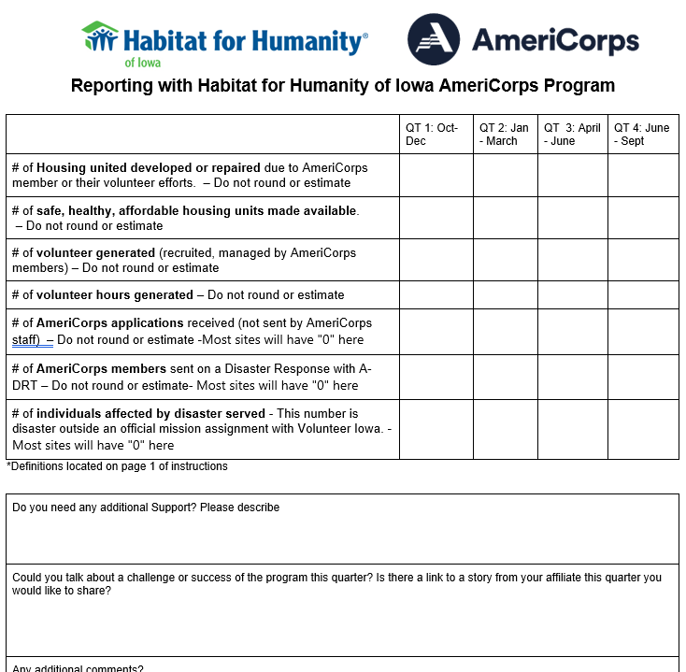
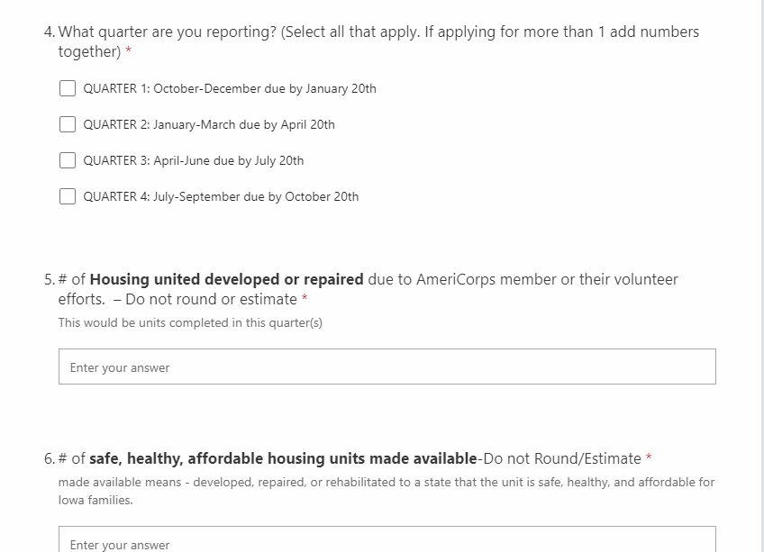

Slide 35
Approve Member Timesheets
Members complete timesheets 2x per month (10th and 25th of each month)
  26th-10th due 12th
  11-25th – due 27th
  Supervisors have an additional 2 days to review
Please review for accuracy
  Time on holiday, weekends, extra accounted for time
  Time to review is monitored in the system
No timesheet will be released for fixing after 90 days
Timesheets are considered a federal document and must be treated seriously.
Common errors: Time on holidays, time on sundays, time while on vacation

Slide 36
Timesheets-submitting a timesheet
Enter the total daily hours for the day. 8:00 am - 4pm= 8 hours.
  Increments of 0, .25, .5, and .75 → 1 hour and 30 minutes = 1.5 hours, 2 hours and 45 minutes = 2.75
These hours are broken into two categories- Direct Service and Training
  Direct Service: Most of your time is direct service. It is when you are not being training. For instance, if you are creating a flyer for an event or driving a client to their job interview.
  Training: Any time you are taking information to improve your skills. For instance, this is a training right now. may spend up to 20% of your total hours on training activities.
DO NOT enter comments in the comments box
DO NOT enter hours until after you have served the hours. You are not allowed to preload your timesheet.

Slide 37
Timesheet - examples
Anthony arrives at service at 7:30am. And serves until 12:30 on site.
Breaks for lunch 30 minutes
Then from 1-4pm, Anthony attends a mandatory training on competent persons.
Time in | Time out | Total Direct Service | Total Training
7:30 | 12:30 | 5 hours
12:30 | 1:00 | 0
1:00 pm | 4:00 pm |  | 3 hours

Slide 38
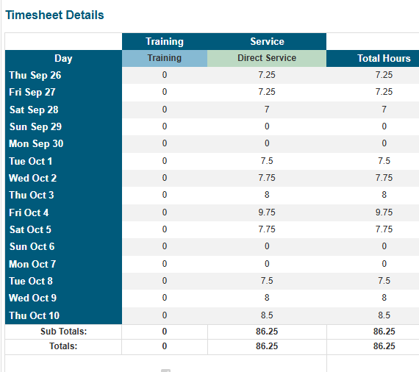
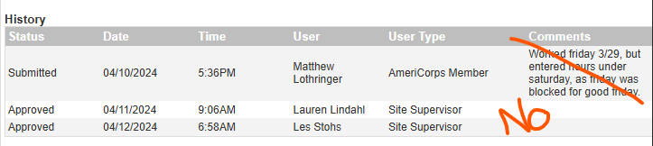
DO NOT enter comments in the comments box
DO NOT enter hours until after you have served the hours. You are not allowed to preload your timesheet.

Slide 39
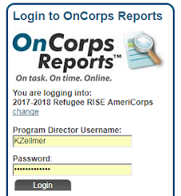
Timesheets- creating an account
Go to ia.oncorpsreports.com
Select year
Login using:
  First letter of your first name and last name
  Example: Katie Sylvis = ksylvis
Temp password: Building1
Create a new password
www.iowahabitat.org/using-oncorps

Slide 40
Monitoring Member hours
Members are required to monitor their hours to ensure they are meeting the requirements of their term of service
  Minimum # of hours
  Total time of contract
  Maintain a normal schedule throughout term
Habitat Iowa Staff monitor this quarterly with our Quarterly Check-Ins, but members are ultimately responsible
OnCorps and the benchmark calculator allow members and supervisors to check on hours regularly.

Slide 41
Consequences of not monitoring hours
If a member is not able to fulfill their member service agreement, a few things can happen
Members will not receive the education award
The members may be receive a favorable review from the program or supervisor.
  No referral letters, recommendations, rehires etc.
All members are encouraged to serve 8 extra hours. This is a buffer incase there is a mistake found on timesheets after they exit. Auditors can remove hours from timesheets and could lead to them losing the ed award.

Slide 42
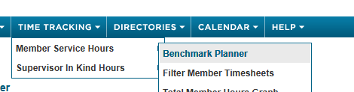
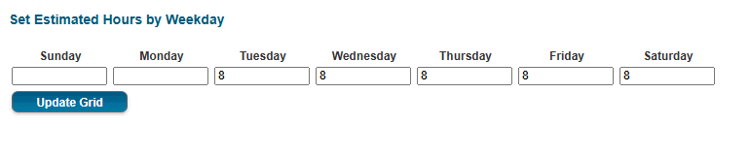
Using OnCorps to check hours
Log into OnCorps
Time Tracking > Benchmark Planner
Enter your normal service schedule across the top
Now you will have a grid of all past and future service days

Slide 43
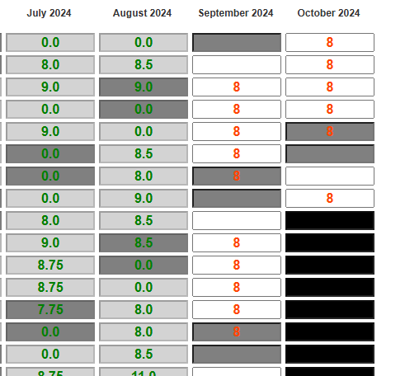
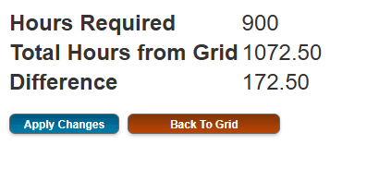
Benchmark planner continued
Green is approved service days
Red it predicted days
The bottom has a total of hours expected to serve with current schedule
You can add in expected vacation days

Slide 44
Time off- Vacation
Must follow the host sites policy. If there is no policy, follow this below
Some flexibility is built into the calendar to accommodate sick and personal leave. Members are ultimately responsible for ensuring they complete all service hour requirements.
Members should make every effort to maintain a regular service schedule. Personal appointments and time off should be scheduled around set service schedule and holiday breaks as much as possible. Members will be encouraged to stay on track to meet the minimum hours required per the member service agreement.
To Take Time off:
NOTIFY SUPERVISOR: You are required to request TIME OFF at least 7 days in advance of the requested time off (Greater Des Moines requires 14 days), unless it is due to illness or an emergency. You need to contact your supervisor for approval. Approved time off is subject to supervisory approval, department staffing needs and established departmental procedures
VARIFY YOU HAVE THE HOURS: Members must also provide the supervisor proof from the Benchmark Planner or OnCorps that they have the time off available (slide 34-6)
*if greater than 2 weeks, Habitat Iowa Program Staff need to be aware to ensure you are not marked as abandoning your service position.

Slide 45
Holidays
Members observe the holidays followed by their host site. Typical Holidays for Habitats:
  New Years
  Good Friday
  Memorial Day
  Independence Day
  Labor Day
  Thanksgiving and Friday after
  Christmas- 2 days
These days are entered as “0” hours on timesheets

Slide 46
But how much time do they get?
It is very difficult to determine the total amount of time off per person. It depends on when they start in the year (before or after Christmas), do they leave service early, are there a lot of snow days
Habitat Iowa provides each member with benchmark planner that shows them their bank of available hours already accommodating for holidays.
If members serves 40 hours every week, they generally have a hefty about of time off.
Members only need a minimum number of hours. Any extra hours does not get them extra pay. We try to get members to take time off throughout the year instead of taking it all at the end.

Slide 47
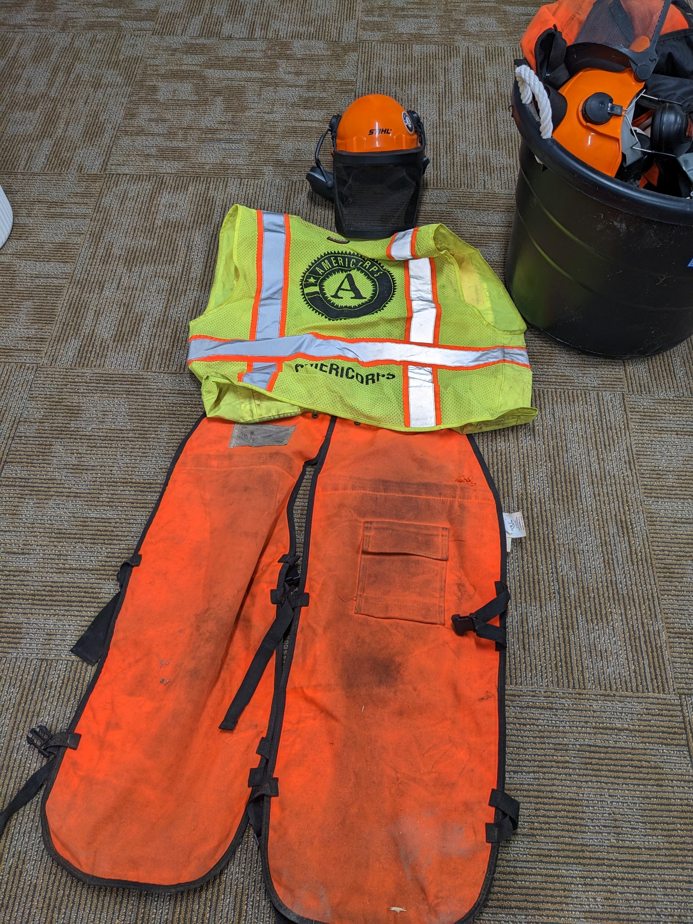
DRESS CODE
It is required to wear the AmeriCorps logo each day
  Habitat provides shirts, sweatshirts, backpacks, stickers, and more
After that, wear the required clothes dictated by the site.
  Example: long pants, close toed hard sole shoes, shirts to get dirty, hard hats, safety glasses, and gloves

Slide 48
Monitoring members activities
ITEM | REPORTING TIMELINE
Any member injury during service that necessitates filing a worker’s compensation report | Within 24 hours
Any member or site supervisor behavioral issues (arrests, harassment) that may result in immediate dismissal from the program or employment | within 24 hours
Any AmeriCorps member dispute resolution or grievance requests | within 24 hours
Any member performing prohibited activities, as defined in Section 8 | within 24 hours
Upon the second occurrence of a member failing to report to service without prior approval | within 24 hours
Member request for a reasonable accommodation | Within 24 hours
Any AmeriCorps member’s behavior issues that result in disciplinary action by the member’s direct supervisor | within 2 business days
Any AmeriCorps member’s request to be exited for cause, compelling circumstance, or to be suspended | within 2 business days
Any AmeriCorps member position description or Member Service Agreement amendment requests, or other change that affects the member’s service activities in Program | within 3 business days

Slide 49
Disciplinary Guidelines
Our goals are to help nurture a member and keep them in the program. However, sometimes members need to be disciplined.
  Progression of Discipline (If not threatening to the program or organization)
  Informal discussion -- You might not know, but These are the rules here.
  Verbal warning -- I am telling you that you are out of line and you must stop
  Written warning -- Create a written document explaining steps for change and how they will be met or the member is fired.
  Termination of Service aka Firing

Slide 50
Release from term of service
Exit for Cause (FIRED/ QUIT)
If a member Exits for Cause (fired/ quit), they will not receive their education award:
Examples:
    Being fired
    To Enroll in School
    To Obtain Employment
    Due to Dissatisfaction with the Program
Compelling personal circumstance
If a member leaves for compelling personal circumstances, they may be eligible for a prorated amount of the education award. CPC means forced to leave service for something outside of their control.
Examples:
    Medical emergency and can’t serve
    The primary supporter of the family becomes ill and the member needs to take another job to support the family.

Slide 51
Prohibited activities
There are many prohibited activities. They are all listed in your member service agreement and here . Themes:
Religion, politics, taking over staff positions, fundraising

Slide 52
Prohibited activities- religious instructions
While serving at your host site, you may not:
Engage in religious instruction
Conduct worship service
Engage in any form of religious proselytization
Full detail here
AmeriCorps members are free to and encouraged to participate in these activities on their own time outside of service

Slide 53
Prohibited activities- politics
While serving at your host site, you may not:
  Attempt to influence legislation (ask a legislator for something)
  Conduct a voter registration
  Participate in political activities such as boycotts, protests, or demonstrations.
Full detail here
AmeriCorps members are free to and encouraged to participate in these activities on their own time outside of service

Slide 54
Prohibited activities- nondisplacement
While serving at your host site, you may not:
Take over duties of other staff or volunteer positions
This could include someone leaving temporarily.
Host sites cannot hire you before the end of your term of service
Full detail here
AmeriCorps members are free to and encouraged to participate in these activities on their own time outside of service

Slide 55
Prohibited activities- fundraising
While serving at your host site, you may not:
raise funds for your nonprofits overall budget
(You may fundraise in very special circumstances)
These special circumstances must be approved beforehand by Habitat Iowa staff and cannot take up more than 10% of your time.
ReStores are considering fundraisers
Full detail here
AmeriCorps members are free to and encouraged to participate in these activities on their own time outside of service

Slide 56
Prohibited activities – Other General ones
While serving at your host site, you may not:
Work in any way connected to a ReStore (fundraising)
Participate in Marketing activities such as social media that is not directly related to your particular service project or AmeriCorps
Referrals for abortions
Assisting, promoting or deterring union organizing
Full detail here
AmeriCorps members are free to and encouraged to participate in these activities on their own time outside of service

Slide 57
AmeriCorps rules and regulations
All information can be found in the
Member Service Agreement

Slide 58
Term of service
Serve your contracted length of time (Start Date to End Date)
Members must complete the minimum total hours required by the End Date listed in the Service Agreement
  Full-Time: 1700 Hours
  Three-Quarter Time: 1200 Hours
  Half-Time: 900 Hours
  Quarter-Time: 450 Hours
  Minimum-time: 300 Hours
Members must maintain an consistent hourly schedule throughout their term as listed in their member service agreement
  Either 40 hours per week or 20 hours per week
  While there will be fluctuation with holidays and vacations, what they don’t want to see is
    First half of contact 20 hours and second half of contract 50 hours – They want to see consistent schedules

Slide 59
Non-Discrimination & harassment policy
Habitat for Humanity of Iowa is committed to providing all of its employees a work environment which is free of discrimination and harassment based upon race, color, sex, sexual orientation, national origin, age, religion, citizenship, political affiliation, disability, or veteran status.
Additionally, it is unlawful to retaliate against any person who files a complaint about such discrimination or harassment.

Slide 60
Drug-Free Workplace Policy
Consistent with the Drug-Free Workplace Act of 1988, Habitat for Humanity of Iowa is committed to providing a workplace that is free from the unlawful manufacture, distribution, dispensation, possession, or use of controlled substances.
Conviction of any criminal drug statute must be reported within 5 business days to the Program Director
The member’s participation in the Program is conditioned upon compliance with the notice requirement

Slide 61
SMOKING / VAPING POLICY
Smoking/Vaping is prohibited in all Habitat Iowa buildings and vehicles. Individual AmeriCorps members, staff, and volunteers follow the tobacco use policy enforced at their placement.
Everyone shall adhere to the following:
Smoking at project sites is allowed during scheduled breaks and lunch only and in designated areas determined in consultation with Leaders.
Smoking/Vaping in unauthorized areas is a serious offense. Since careless smoking causes many fires, members must strictly adhere to the smoking regulations to protect themselves, others, and Habitat Iowa.
During extreme fire conditions or based on Host Site policy, absolutely no smoking is allowed in the field.
There is to be no smoking in Habitat Iowa vehicles.

Slide 62
Informed Consent Policy
With Member consent, Habitat for Humanity of Iowa, ICVS, and CNCS may:
Release your name, interests, and any training you have received
Write a recommendation or give a verbal recommendation for employment, etc., at the end of your term of service
Photograph you at your service site for recruitment or promotional purposes
Members provide consent by signing the Service Agreement

Slide 63
Reasonable Accommodation Policy
Programs and activities must be accessible to persons with disabilities. Habitat for Humanity of Iowa and Habitat Affiliates must provide reasonable accommodations to the known mental or physical disabilities of otherwise qualified members, service recipients, applicants and staff.
All selections and project assignments must be made without regard to the need to provide reasonable accommodation.

Slide 64
Grievance Procedures
Habitat for Humanity of Iowa strives to resolve member concerns as they arise.
In the event that informal efforts to resolve disputes are unsuccessful, AmeriCorps members and other interested individuals may seek resolution through the grievance procedures detailed on in the back of the Member Service Agreement.

Slide 65
Extra Member Expectations
Quarterly 1:1s
Communicate effectively with staff on time off needs
Monitor hours personally
Show up to service on time
Great Story reporting
Communicate with Habitat Iowa Staff through Email and phone

Slide 66
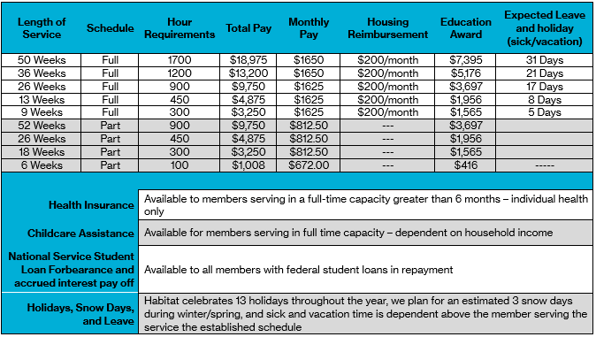
Member benefits
What do members receive in exchange for service?
www.iowahabitat.org/member-page for more details

Slide 67
Member benefits
Living allowance: The contracted amount of money paid in equal amounts each pay period throughout the term of service
Education Award: . It can be used towards past federal student loans or towards future education expenses through Title IV schools.
Housing Stipend:. Reimbursement of $200 will be provided monthly after receipt of payment is provided.
National Service Forbearance: Members with qualifying federal student loans are able to put those loans into a forbearance ,
Accrued Interest Payments: Members with qualifying federal student loans and have those loans placed in National Service Forbearance, will qualify to have all accrued interested paid off at the end of the year through the National Trust.
www.iowahabitat.org/member-page

Slide 68
Member benefits
Health Insurance: Any member serving in full-time status (40 hours per week) over 6 months is eligible for the Corps Network health insurance, which is provided through Cigna.
Childcare assistance: Members serving in a full-time capacity (40 hours per week) may be eligible for childcare assistance.
Training and professional development: Habitat for Humanity of Iowa provides training throughout the year
Member Emergency Fund : $500 one-time payment through Volunteer Iowa to cover unexpected costs
Member Assistance Program: Mental Health and Life Coaching Services for member and family
Public Assistance: Most AmeriCorps Members apply for SNAP benefits. – Living allowance does not count as income for them.
Workers Compensation: Habitat Iowa carries this insurance for all members.
www.iowahabitat.org/member-page

Slide 69
Branding and Media Inquiries
Must have a “AmeriCorps Serving Here” sign
Member must wear AmeriCorps logo especially if being videoed or photographed
All media inquires can be sent to Habitat Iowa staff

Slide 70
Need more information?
Ask me
Ask your supervisor
Using OnCorps: www.iowahabitat.org/using-oncorps
Member Handbook- www.iowahabitat.org/member-page
Member Service Agreement (in an email from Adobe Sign)
Habitat Iowa: www.iowahabitat.org/americorps
AmeriCorps: www.americorp.gov

