Slide 1
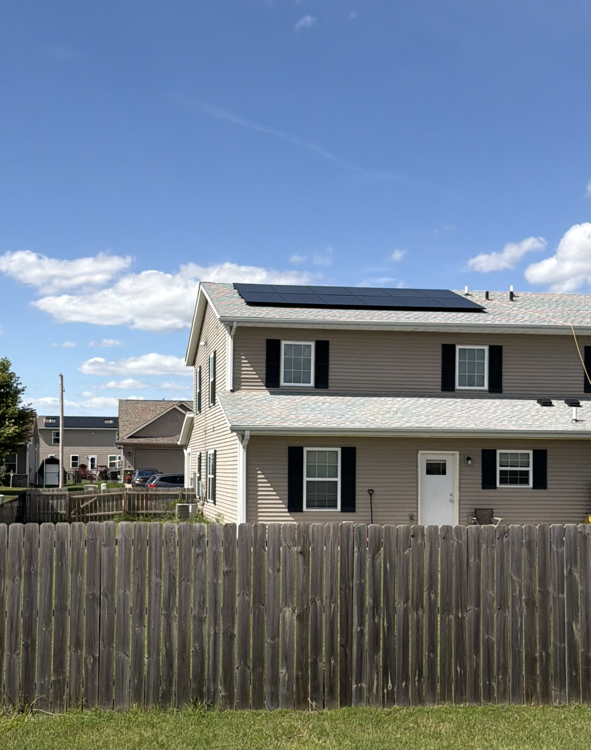
What’s the Impact?
Lessons
Clarifications and Framework
Mid-American and Alliant service
Net metering
Home Construction Matters
  Roof line
  HVAC system
  Tightness
Solar panels save our families a lot of money
Tracked by month of usage, not date of bill
Average daily usage (except one home)
  Monthly billing cycle has varying number of days
Estimates on costs due to budget billing
Track electric charges but not electric bill
  Each utility has varying service and connection fees

Slide 2
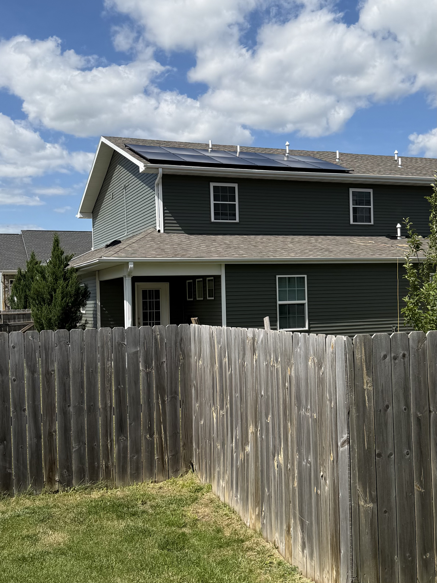
Impact- 253 Sierra Park Drive
House Facts
Roof Slope | South
Heating | Gas
Insulation | Spray foam, exterior hardboard
Year Constructed | 2019
Array Size | 4.25 kW

Slide 3
Impact- 223 Sierra Park Drive
House Facts
Roof Slope | South
Heating | Gas
Insulation | Spray foam, exterior hardboard
Year Constructed | 2017
Array Size | 5.1 kW

Slide 4
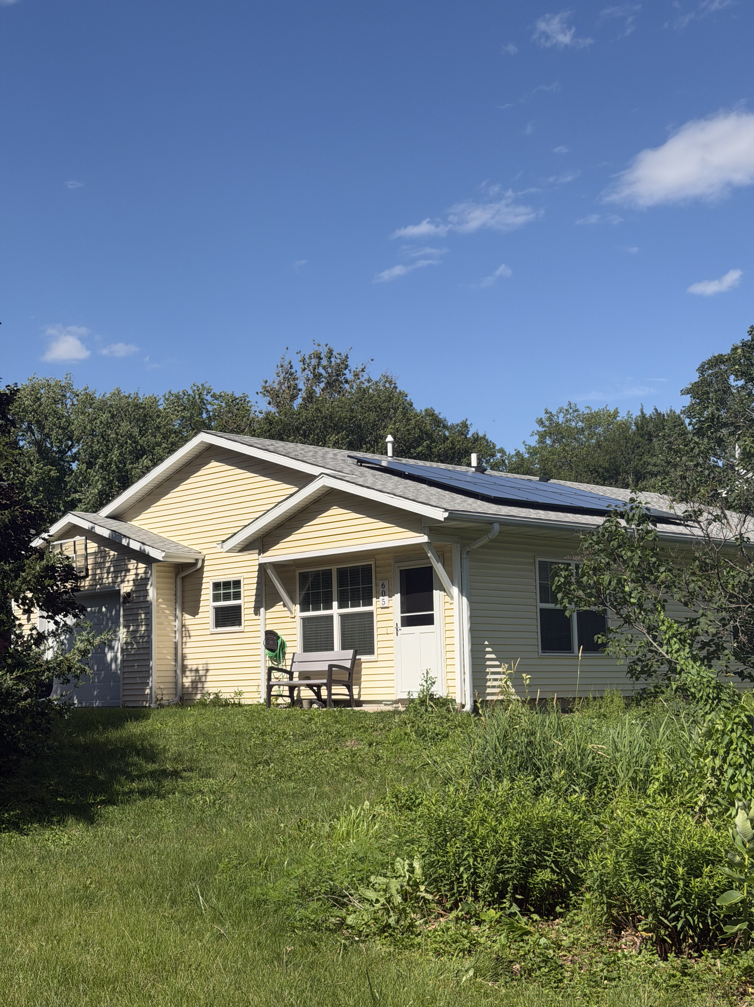
Impact-605 8th Ave
House Facts
Roof Slope | South
Heating | Gas
Insulation | Spray foam, exterior hardboard
Year Constructed | 2016
Array Size | 4.25 kW

Slide 5
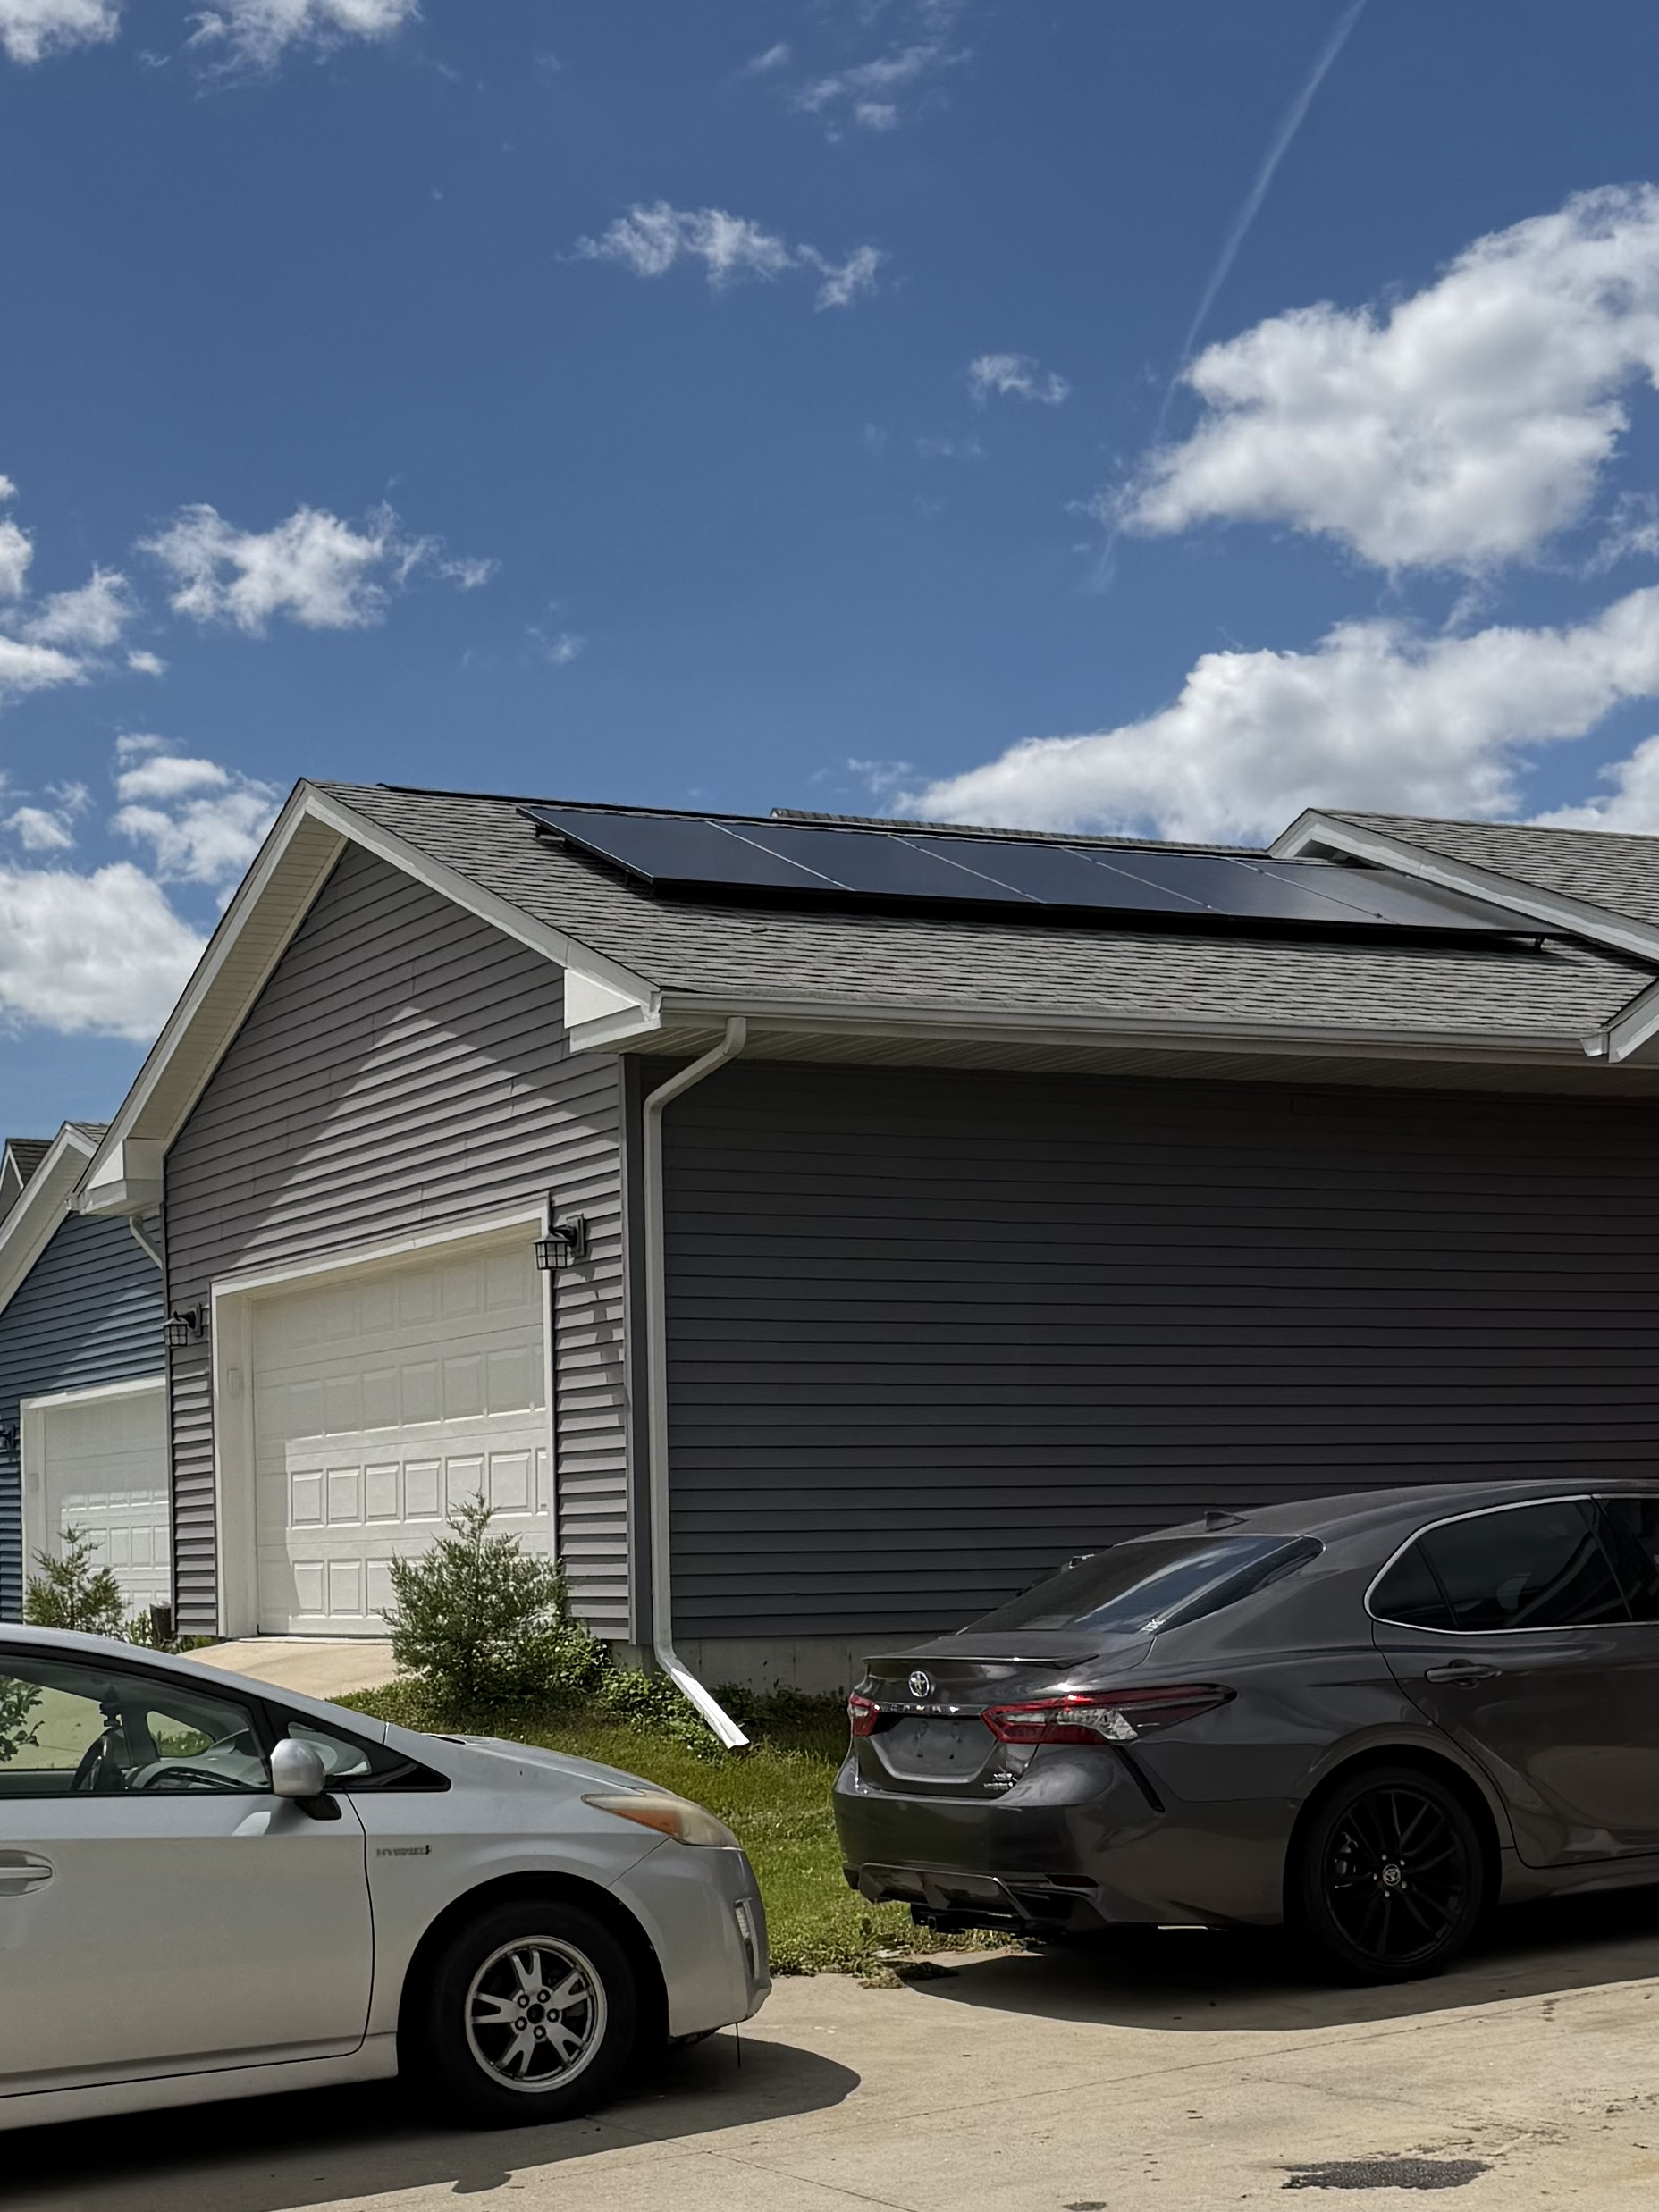
Impact-2653 Blazing Star
House Facts
Roof Slope | East, West
Heating | Heat Pump
Insulation | Spray foam, exterior hardboard
Year Constructed | 2021
Array Size | 4.74 kW

